Slide 1


Virtual Labs : Overview
Aspects Covered:
About VLabs
Outreach
Community Efforts
Roadmap
Pushpdeep Mishra - IIT Bombay
pushpdeep@iitb.ac.in

Slide 2
Virtual Labs : Introduction
Why Do we need a lab ?
To (interactively) test a theoretical concept.
To become familiar with real world hardware.
Pushpdeep Mishra - IIT Bombay
pushpdeep@iitb.ac.in

Slide 3
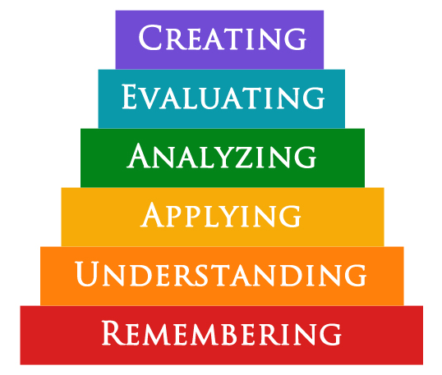
Virtual Labs : Introduction
Bloom’s Taxonomy - Classification of LO’s
Hypothesis or formulate or construct
Justification of a decision or theory
Increasing level of difficulty*
Analyse or distinguish
Apply concepts
Understand concepts
Recall known concepts
*need not be true for all, weak students may find Remembering and Understanding difficult too.
Pushpdeep Mishra - IIT Bombay
pushpdeep@iitb.ac.in

Slide 4
Virtual Labs : Introduction
The Ideal Lab
A student team is assigned a concept.
The team assembles an appropriate rig.
They generate data and test the theory.
They dismantle and store away the set up.
Pushpdeep Mishra - IIT Bombay
pushpdeep@iitb.ac.in

Slide 5
Virtual Labs : Introduction
Problems with Physical Labs
Equipment not available.
Available, but limited access.
Expensive. Equipment, reagents…
Hazardous.
Pushpdeep Mishra - IIT Bombay
pushpdeep@iitb.ac.in

Slide 6
Virtual Labs : Introduction
Features of MoE VLabs
Remote-access to simulation-based Labs in various disciplines of Science and Engineering.
Enthuse students to conduct experiments by arousing their curiosity. This would help them in learning basic and advanced concepts through remote experimentation.
A complete Learning Management System around the Virtual Labs where the students/ teachers can avail the various tools for learning, including additional web-resources, video-lectures, animated demonstrations and self-evaluation.
~1000 Experiments hosted covering 9 Disciplines of Engineering and Science.
Mapped onto AICTE and UGC curriculum.
Pushpdeep Mishra - IIT Bombay
pushpdeep@iitb.ac.in

Slide 7
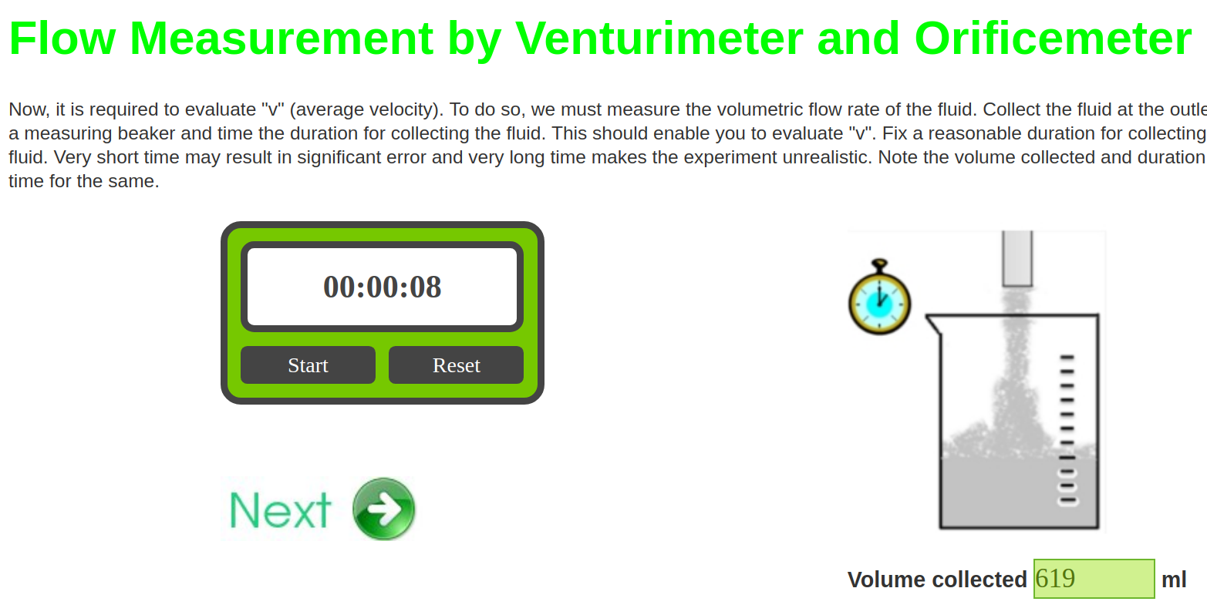
Virtual Labs : Introduction
The VLabs Interface
Pushpdeep Mishra - IIT Bombay
pushpdeep@iitb.ac.in

Slide 8
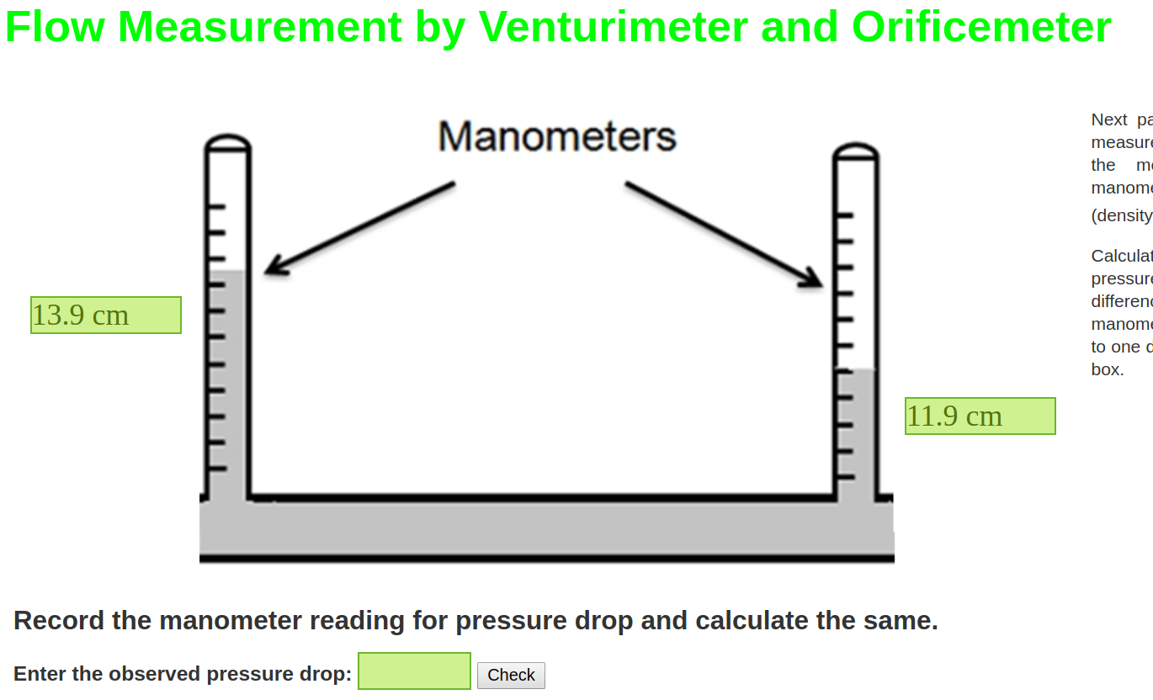
Virtual Labs : Introduction
The VLabs Interface
Pushpdeep Mishra - IIT Bombay
pushpdeep@iitb.ac.in

Slide 9
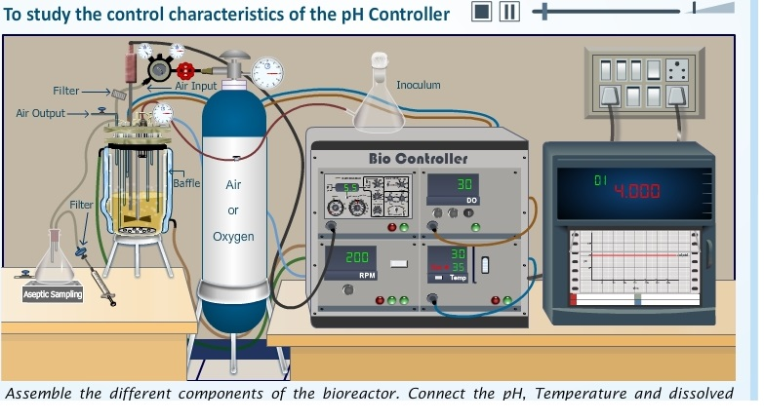
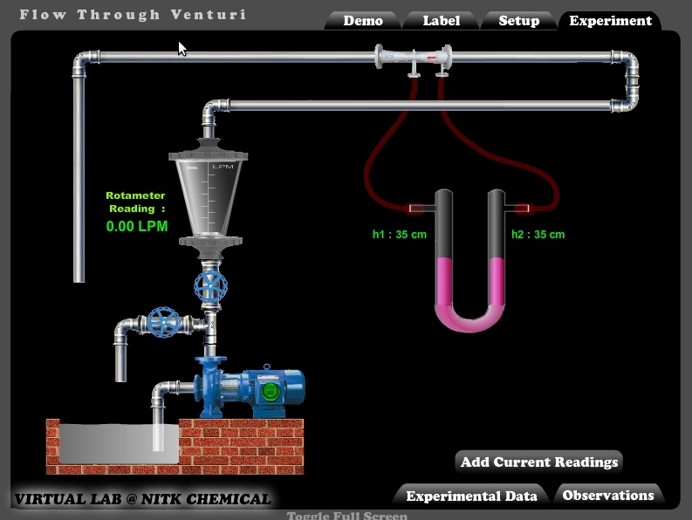
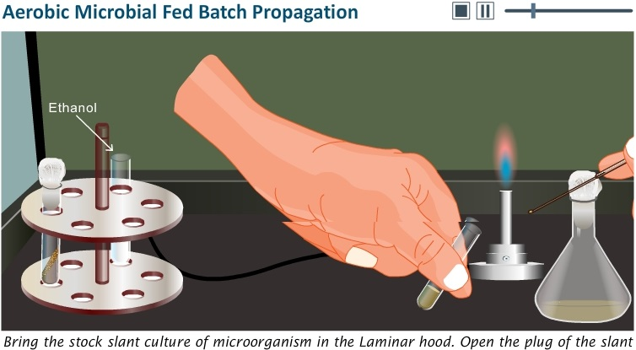
Virtual Labs : Introduction
The VLabs Interface
Pushpdeep Mishra - IIT Bombay
pushpdeep@iitb.ac.in

Slide 10
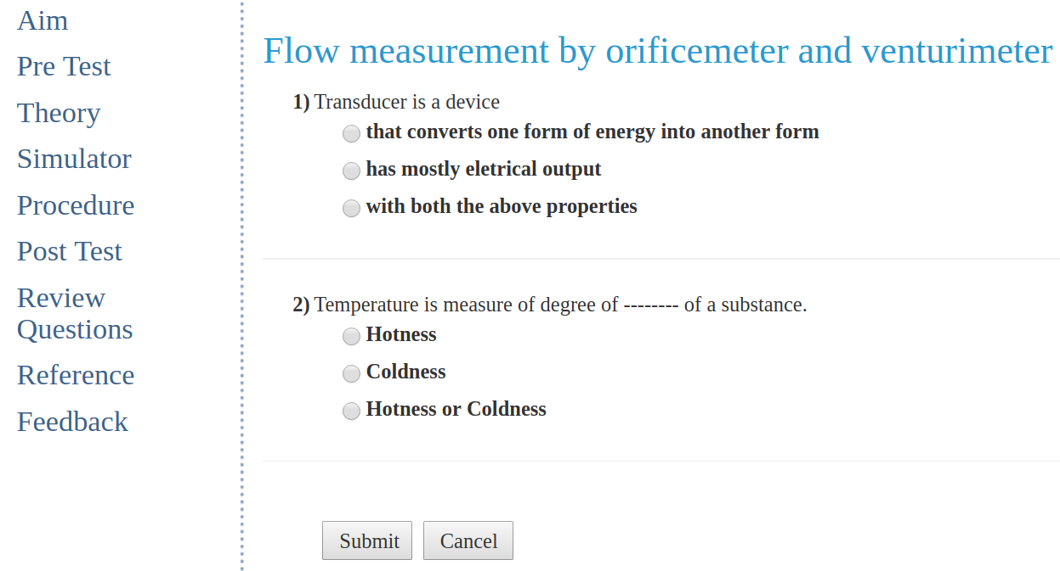
Virtual Labs : Introduction
The VLabs Interface
Pushpdeep Mishra - IIT Bombay
pushpdeep@iitb.ac.in

Slide 11
Virtual Labs : Introduction
The MoE VLabs Consortium
IIT Bombay
IIT Kanpur
IIT Guwahati
NIT Karnataka
IIT Roorkee
IIT Delhi
IIIT Hyderabad
IIT Kharagpur
COE Pune
Amrita Vishwa Vidyapeetham
Dayalbagh Educational Institute
Pushpdeep Mishra - IIT Bombay
pushpdeep@iitb.ac.in

Slide 12
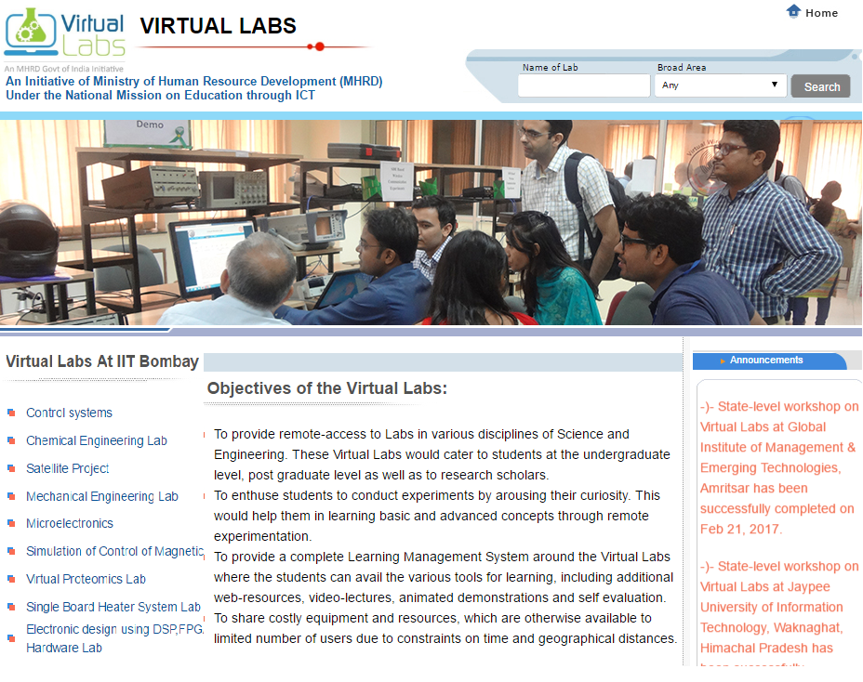
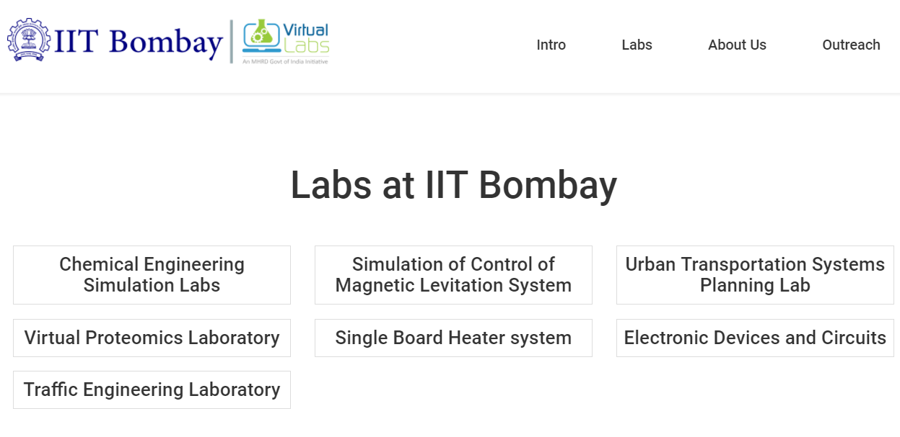
Virtual Labs : Introduction
VLabs Portal
vlab.co.in
Pushpdeep Mishra - IIT Bombay
pushpdeep@iitb.ac.in

Slide 13
Virtual Labs : Outreach
VLabs IITB Outreach
IITB has been part of the vastly successful MoE (NME-ICT) Virtual lab for the past 10 years.
  IITB and VLab Outreach.
  (Numbers in brackets are national overall counts)
    300 Nodal Centres (~2000)
    9000 workshops
    21,00,000 experiment uses (~45,00,000 )
    Engaged with 11,000 Teachers and 6,00,000 Students via large-scale bootcamps and FDPs
Pushpdeep Mishra - IIT Bombay
pushpdeep@iitb.ac.in

Slide 14
Virtual Labs : Outreach
VLabs IITB Outreach
Our Outreach model:
  Nodal Centres:
    A college / institute is a Nodal Centre
    Nodal Coordinator: rollout efforts the Nodal Centre
    Department Coordinator : rollout at the department level
    Nodal Technical Coordinator: Students clubs , Tech training at the Nodal Centre
  Regional Centres :
    Network of several Nodal Centres in a region
    Regional Coordinator: rollout efforts in the region
    Regional Technical Coordinator: Student clubs, Tech training in the region
Pushpdeep Mishra - IIT Bombay
pushpdeep@iitb.ac.in

Slide 15

Community Efforts
VLabsDev
vlabs.iitb.ac.in/vlabs-dev/
Pushpdeep Mishra - IIT Bombay
pushpdeep@iitb.ac.in

Slide 16
VLabsDev
Motivation Behind VLabsDev
  Over 700 Universities in the country
  The set of 1000+ experiments cover approximately 50 % of the core syllabus
Pushpdeep Mishra - IIT Bombay
pushpdeep@iitb.ac.in

Slide 17
Community Efforts
VLabsDev Milestones
Content Development through VLabsDev
    8 National BootCamps
    1000 Students and Teachers trained.
    250 Expts contributed by the community. Now science expts as well.
    Successfully innovated in the area of community-based content generation.
    Achieved expertise on pedagogy, storyboarding complex ideas, and simulator development.
    Identifying talents and build the pipeline towards contribution and innovation.
Pushpdeep Mishra - IIT Bombay
pushpdeep@iitb.ac.in

Slide 18
Community Efforts
Labs Developed by Community
Lab Name | Expts in lab | Developer Name | Developed by the Institute
Digital Applications Lab | 14 | Prof Tanuja Khatavkar | PVG's COET Pune
Introduction to PHP | 13 | Prof.Minal R. Apsangi,Prof. Urmila .Kalshetti | PVG's COET Pune
Machine Learning Lab | 11 | Prof. J H Nirmal | K J Somaiya COE, Mumbai
Database Lab | 5 | Prof. Jyoti Pareek,Prof. Bhumika Shah | Gujarat University, Ahmedabad
Computer Graphics Lab | 8 | Prof. Anil Bhadgale | PVG's COET Pune
Engineering Physics | 5 | Prof.Bhagwan Toksha | MIT Aurangabad
Cryptography and Network Security | 2 | Prof.Pradeep Kumar Singh | Jaypee University, Solan.
Pushpdeep Mishra - IIT Bombay
pushpdeep@iitb.ac.in

Slide 19
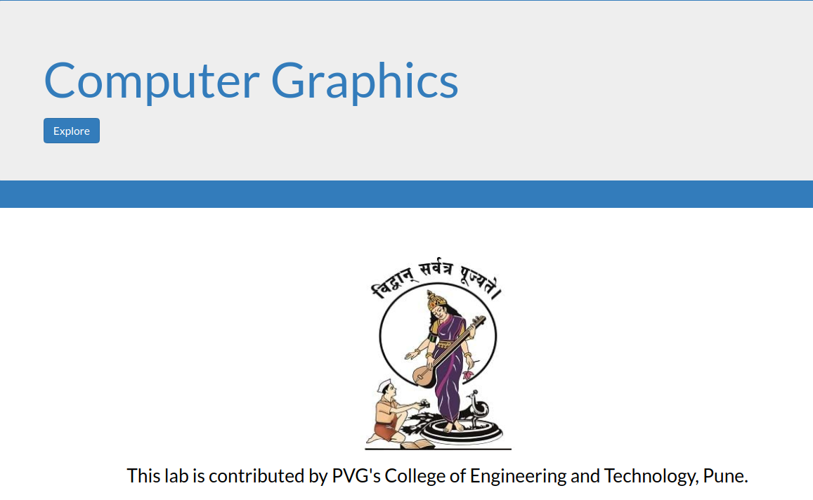
Community Efforts
Labs Developed by Community
Link : http://vlabs.iitb.ac.in/vlabs-dev/labs/cglab/index.php
Pushpdeep Mishra - IIT Bombay
pushpdeep@iitb.ac.in

Slide 20
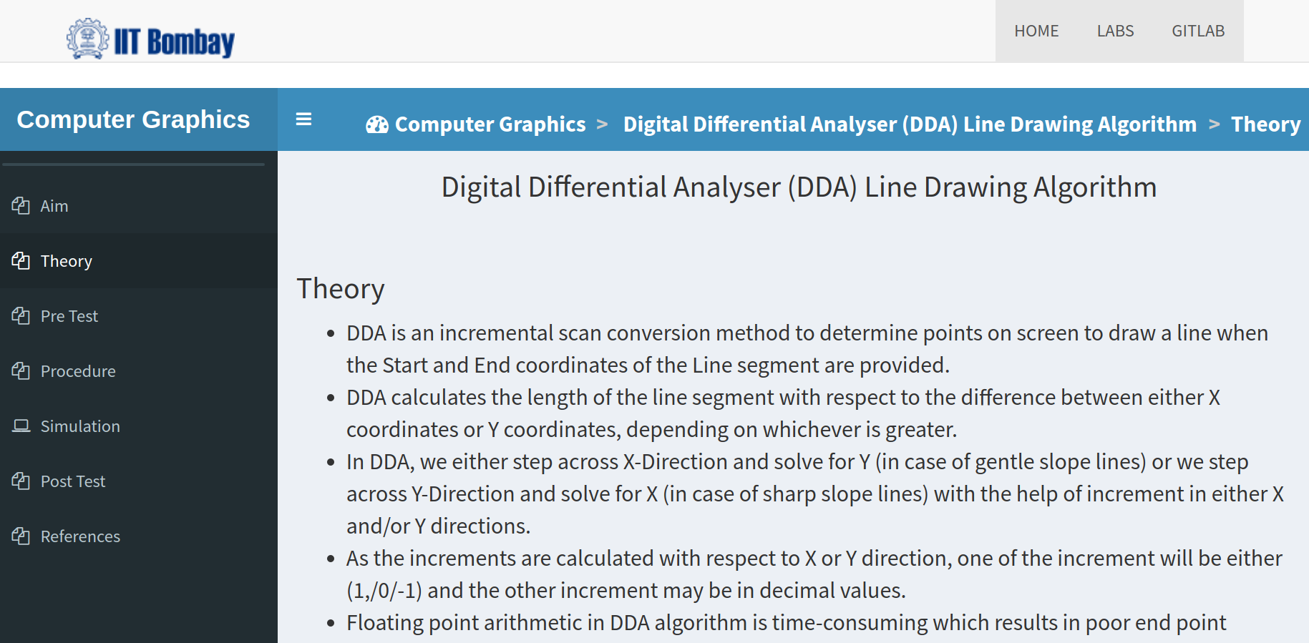
Community Efforts
Labs Developed by Community
Pushpdeep Mishra - IIT Bombay
pushpdeep@iitb.ac.in

Slide 21
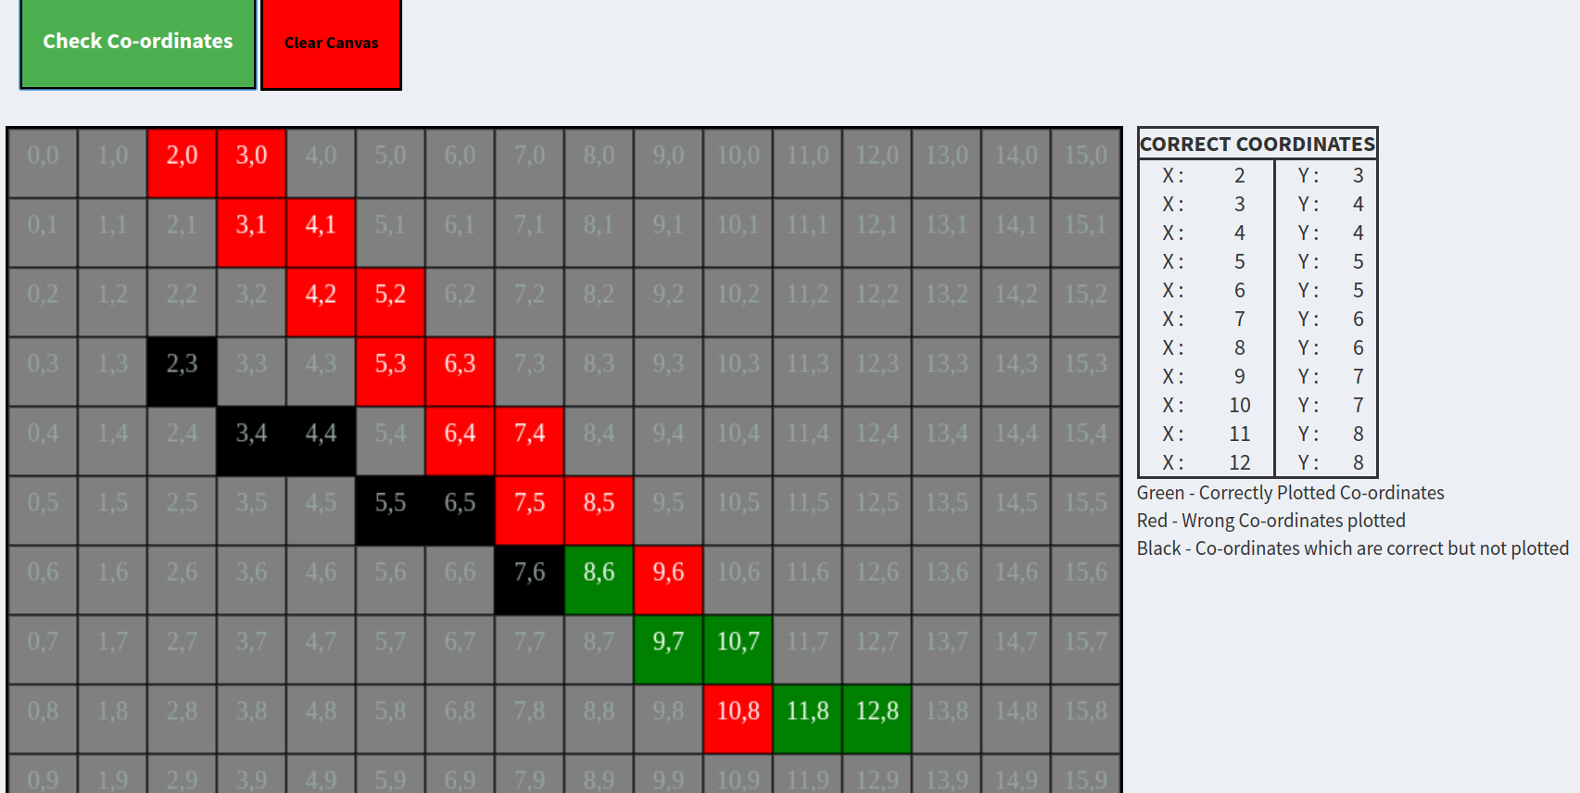
Community Efforts
Labs Developed by Community
Pushpdeep Mishra - IIT Bombay
pushpdeep@iitb.ac.in

Slide 22
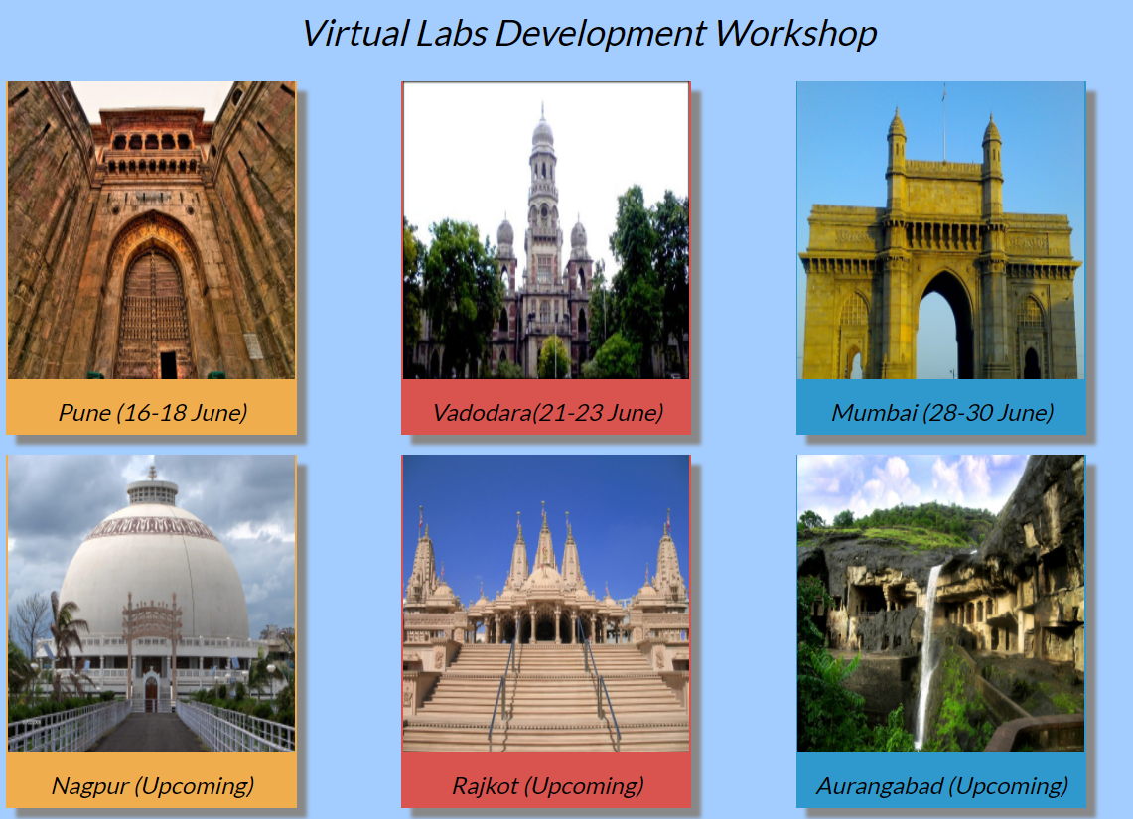
Community Efforts
Bootcamps
Pune
Vadodara
Mumbai
Nagpur
Rajkot
Aurangabad
Pushpdeep Mishra - IIT Bombay
pushpdeep@iitb.ac.in

Slide 23
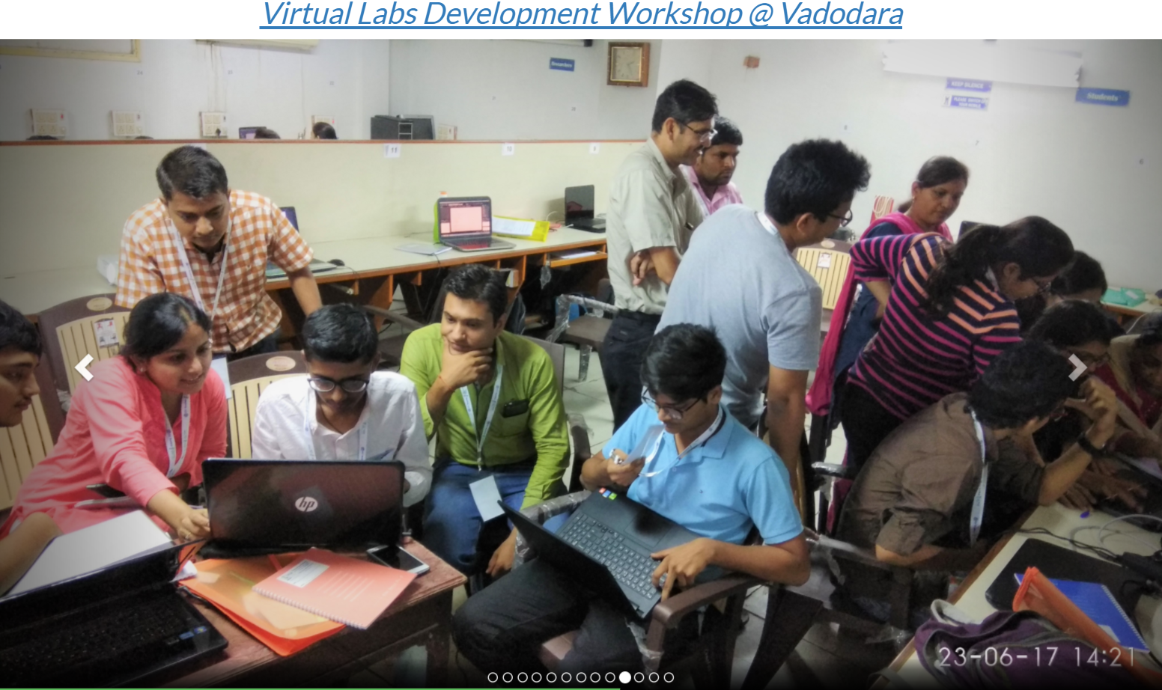
Community Efforts
Bootcamps
Pushpdeep Mishra - IIT Bombay
pushpdeep@iitb.ac.in

Slide 24
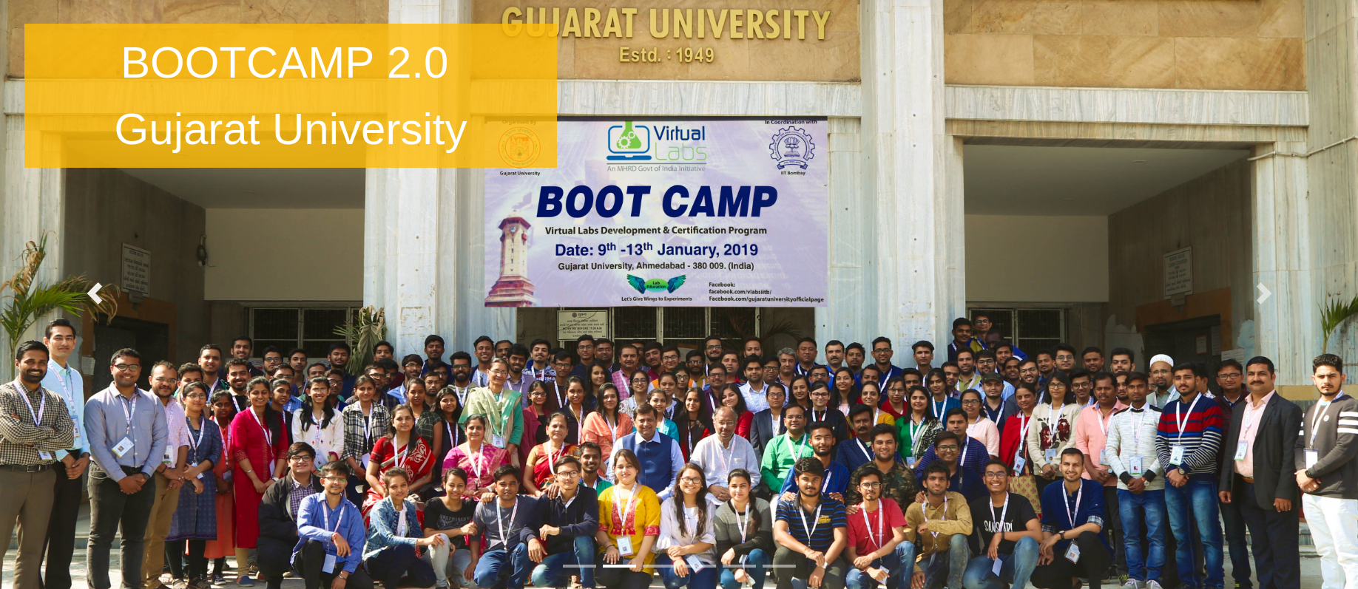
Community Efforts
Bootcamps
Pushpdeep Mishra - IIT Bombay
pushpdeep@iitb.ac.in

Slide 25
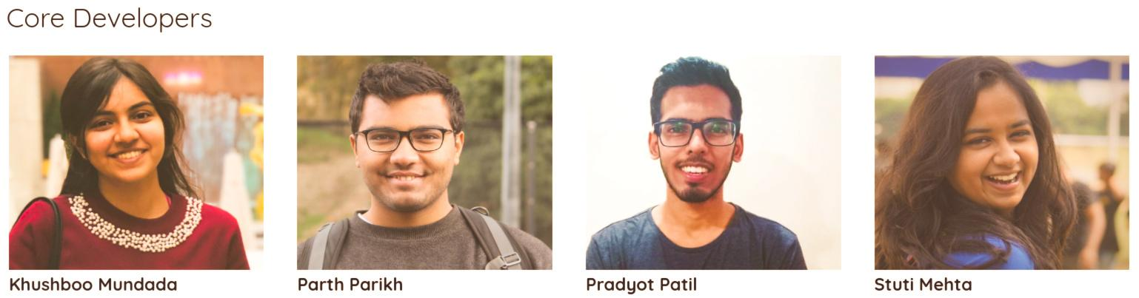
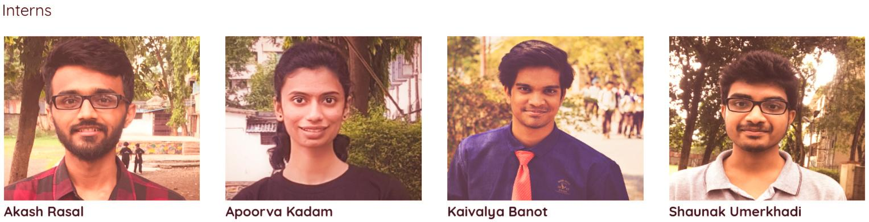
Community Efforts
Internships & Student Clubs
Pushpdeep Mishra - IIT Bombay
pushpdeep@iitb.ac.in

Slide 26
Community Efforts
Evolution of BootCamps
2018 | First National BootCamp, Marwadi University, Rajkot | 25 Teams, 2 faculty + 3 students in each team. Duration 5 days, 10 hrs / day. Teams could develop a complete simulation. Quality of simulation still a basic.
2019 | Second National BootCamp, Gujarat University, Ahmedabad | 30 Team, 1 faculty + 3 students in each team. Duration 5 days, 12 hrs / day. Online Pre-BootCamp sessions : Pedagogy training completed before joining the BootCamp. Certification process included. 1 experiment with lab manuals : Simulations pass the final reviews.
Pushpdeep Mishra - IIT Bombay
pushpdeep@iitb.ac.in

Slide 27
Community Efforts
Evolution of BootCamps
2019 | First National BOOTATHON : (REC Banda : Kanpur) (BootCamp+Hackathon) | Teams structure: 1 Faculty, 4 Student Developers Duration 7 Days, 12 hrs / day. Pre-Training: Self-paced MOOCs, Webinars. Two parallel tracks : A. Faculties to submit documentations. B. Students to submit a demo simulation before the event Certified Faculties from 3 BootCamps, invited as Experts, become National Level Peer Reviewers. Online content review by the experts during the Bootathon Extended Event due to emergency : resulted into online mode of development. 30 Experiments : All Certified and Beta Hosted. : Platinum Gold and Silver Certifications. : Full Labs Completed !
Pushpdeep Mishra - IIT Bombay
pushpdeep@iitb.ac.in

Slide 28
Community Efforts
Evolution of BootCamps
2020 | #Lockdown BOOTATHON Online | Special training program for Faculties & Students through : Self Paced MOOCs and phase-wise mentoring via online conferencing. Over 10 Review Iterations Entirely conducted online. 25 experiments completed. Filling the Syllabus Gap.
Pushpdeep Mishra - IIT Bombay
pushpdeep@iitb.ac.in

Slide 29
Community Efforts
Contents covered during Bootcamp
Registration : Teams register and propose new lab, submit pedagogy, 1 month before the event.
Selection: 25-30 teams are shortlisted based on the pedagogy submitted.
Pre-BootCamp: Training on Storyboarding, Git other FOSS tools begins 15 days in advance.
Day 1: Advance training on Pedagogy + Git + Markdown , followed up by review from Mentors
Day 2: Training on Storyboarding, HTML5, CSS & Javascript
Day 3: Javascript based tasks are assigned for creating Canvas and Animations.
Day 4 - 5 : Teams begin to design their simulators.
Day 6: Review of the developed experiments + Team Showcase + Beta hosting.
Post-BootCamp: Teams are given additional 15 days to test + clean up issues.
Certification: Teams are certified after they have qualified the review process.
Pushpdeep Mishra - IIT Bombay
pushpdeep@iitb.ac.in

Slide 30
Community Efforts
Review Process
  Content Development Process: Rigorous content review process to ensure the quality. May directly affect users attentions and usage.
    Step 1 : Syllabus gap finding
    Step 2 : Lab development proposal
    Step 3 : Review of Proposals
    Step 4 : Development of Pedagogy & Storyboards
    Step 5 : Review of Storyboards (Step 4 & 5 iterative process)
    Step 6 : Code development with code reviews
    Step 7 : Peer Review of the developed content
    Step 8 : Beta hosted to identify issues and users feedbacks
    Step 9 : Fixing of bugs incorporating feedbacks
    Step 10 : National Review of the developed content
    Step 11 : Final fixes (Step 10 & 11 iterative process)
    Step 12 : Nationally hosted
Pushpdeep Mishra - IIT Bombay
pushpdeep@iitb.ac.in

Slide 31
Roadmap
Rollout
Identifying additional Regional Centers.
Bootcamps nationwide for development.
More Universities to include VLabs in their curriculum.
Emphasis to Polytechnic colleges.
Pushpdeep Mishra - IIT Bombay
pushpdeep@iitb.ac.in

Slide 32
Roadmap
Bootcamp
Local funding support.
Process continues to be refined to bring out better labs
More emphasis on the Pre-Bootcamp sessions
Certification of developers.
Expert review during the Bootcamp itself.
Pushpdeep Mishra - IIT Bombay
pushpdeep@iitb.ac.in

Slide 33
Roadmap
VLabsDev
Open Vlabs-Dev to VLNC developers.
Support for conducting more BootCamps nationally.
Focus on browser based and mobile first approach.
MOOCs based training for content development
Student Clubs
Pushpdeep Mishra - IIT Bombay
pushpdeep@iitb.ac.in

Slide 34
Roadmap
VLabsDev
The VLabsDev community:
    Progressive Virtual Labs
    AI/ML models to guide self learning.
    DIY lab rigs.
    Hardware based projects for social innovation
Pushpdeep Mishra - IIT Bombay
pushpdeep@iitb.ac.in

Slide 35
Roadmap
VLabsDev
In summary, we engage with our community on
    Rollout
    Content Development
    H/W Labs
    Social impact Innovation
Pushpdeep Mishra - IIT Bombay
pushpdeep@iitb.ac.in

Slide 36

Roadmap
Thanks
The Virtual labs team IIT Bombay
vlabs.iitb.ac.in
Department of Chemical Engineering,
IIT Bombay, Powai. Mumbai 76
Email: manager1@vlabsdev.in
IIT Bombay
Pushpdeep Mishra - IIT Bombay
pushpdeep@iitb.ac.in

