Slide 1
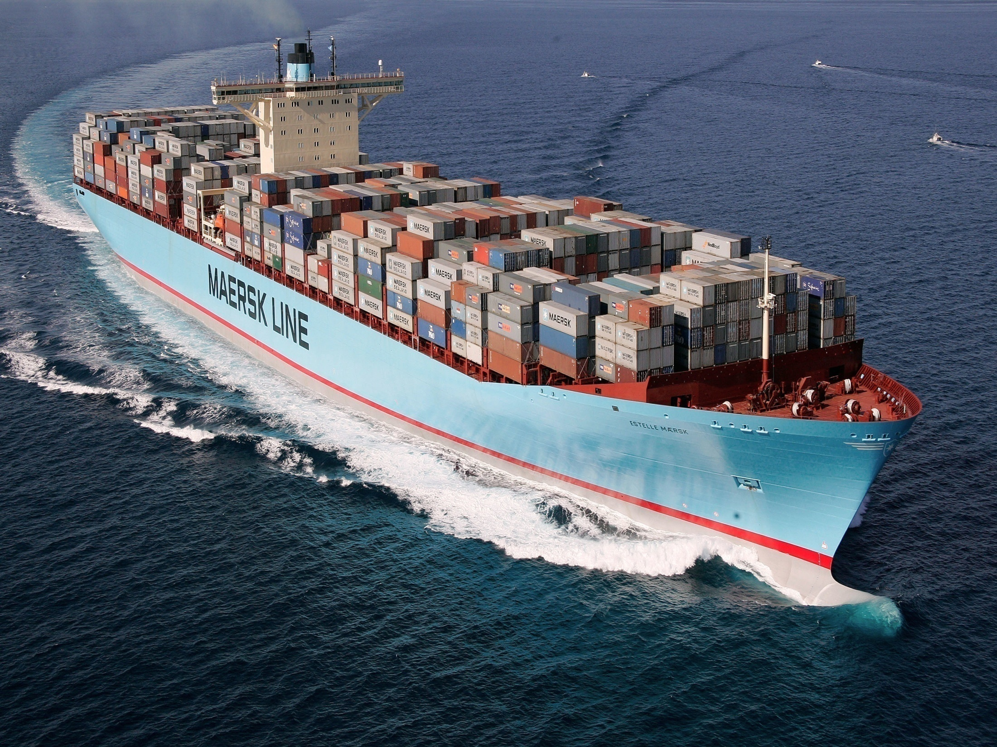
A PRESENTATION ON ‘INDUSTRIAL SAFETY’
PRESENTED BY ,
TOM THOMAS (B-TECH SEM 5)
AKSHAY SACHDEV C P (B-TECH SEM 1)
EUROTECH MARITIME ACADEMY
COCHIN,KERALA

Slide 2

TABLE OF CONTENTS
INTRODUCTION
WHAT IS INDUSTRIAL SAFETY ?
SAFETY IN SHIPPING
INJURIES AND ACCIDENTS ONBOARD
CAUSES FOR HUMAN ERRORS
RECTIFICATION METHODS
CONCLUSION

Slide 3

INTRODUCTION
INDUSTRIAL SAFETY
Safety the term used to describe the whole of safety and health activities, is a combination of many policies, processes, procedures, actions and decisions.
The state in which the risk of harm (to persons) or damage (to property or the environment) is limited to an acceptable level.
Integral part of developmental planning of any country.

Slide 4
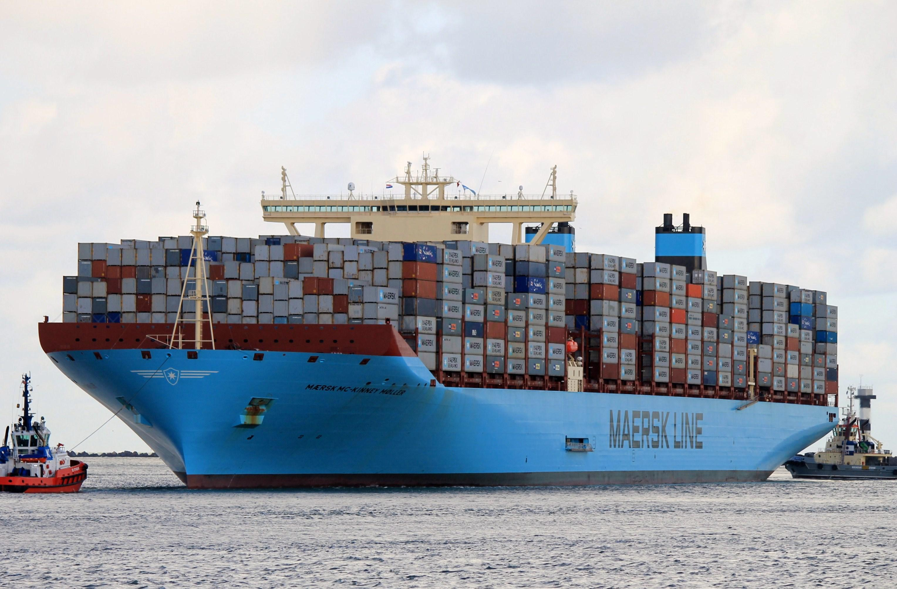
SHIPPING INDUSTRY
Shipping is perhaps the most international of all the worlds great industries and one of the most dangerous – IMO,2002
There are over 140,000 ship and 170,000 ship owner and manager entries in maritime transportation industry.
The least regulated mode of transportation.
Represents a large capital investment that translates into a large cost per day.

Slide 5

WHY SAFETY IS REQUIRED ON BOARD SHIPS…..?
1
Most accidents occur due to violations of basic safety principles
2
failure to follow established work instructions or procedures
3
due to lack of proper training or familiarization.

Slide 6
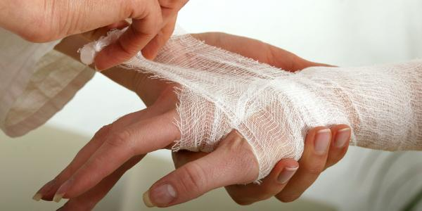
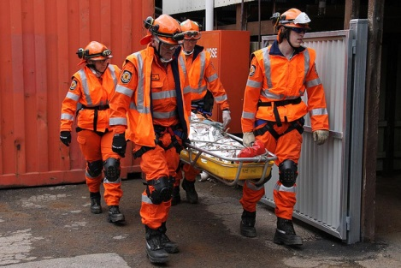
INJURIES AND ACCIDENTS ONBOARD SHIPS
Merchant shipping is known to be an occupation with a high rate of fatal injuries caused by organizational accidents and maritime disasters.

Slide 7




PERSONAL ISSUES
FATIGUE
STRESS
HEALTH
NON-TECHNICAL SKILLS

Slide 8
FATIGUE
extreme tiredness resulting from mental or physical exertion or illness.
considered an internal precondition for unsafe acts because it negatively affects the human operator's internal state

Slide 9
REASONS FOR FATIGUE
Excessive stress
Disturbed sleep
Home sickness
Excessive noise levels and high temperature causing physical strain.
Elongation of sailing contract
Adverse weather condition leading to seasickness
High job demand and consecutive long working days

Slide 10
STRESS
Stress has been identified as a contributory factor to the productivity and health costs of an organization as well as to personnel health and welfare.
Most seafarers reported occasional to frequent stress at sea (80%). There were inter-departmental differences in stress levels, over 65% of engineers, 60% of crew, and over 60% of masters report moderate to high stress levels.
Exposure to elevated stress levels for an extended period of time leads to negative mental and physical health outcomes.

Slide 11
HEALTH
The important observations are listed below:
prevalence of addictions (69%)
irregular use of personal protective equipments (PPEs)
presence of hypertension (20%)
overweight (53%)
osteoarthritis (10%)
hearing loss (25%)
poor self-care.

Slide 12
NON-TECHNICAL SKILLS
additional set of competencies that are used integrally with technical shipping skills.
SITUATION AWARENESS
COMMUNICATION
TEAM WORK
LEADERSHIP

Slide 13


SITUATION AWARENESS
The ability of an individual to possess a mental model of what is going on at any one time and also to make projections as to how the situation will develop.

Slide 14


INEFFECTIVE COMMUNICATION
One of the core skills central to effective and safe production
and performance in all high-risk industries.
The results of miscommunication ranged from mild annoyance to formation of potentially hazardous situations.

Slide 15


INEFFECTIVE TEAM WORK
Teamwork as a part of the human factor is considered to be an important factor for safe performance in the shipping industry.
If it is not effective it will affect the entire working scenario of the ship.

Slide 16
OPERATING & EMERGENCY ROOM TEAMS
MEDICAL EMERGENCY TEAM
FIRE RESCUE UNITS
ENGINE ROOM UNIT
BRIDGE UNIT
INTENSIVE CARE UNITS
ONBOARD CREW

Slide 17
LACK OF LEADERSHIP
WITHOUT PROPER LEADERSHIP CONTROLLING OF SHIP AND ITS CREW IS IMPOSSIBLE
The process of interaction between leaders and followers, through which leaders can exert their influence on followers to achieve organizational safety goals.

Slide 18
RECTIFICATION METHODS
SAFETY TRAINING
Establish a safety culture in which employees themselves help promote proper safety procedures while on the job.
with the establishment of new, hands-on, innovative effective safety training which will ultimately lead to an effective safety culture.

Slide 19
ENGINE ROOM RESOURCE
MANAGEMENT
Introduced in the 1980's
Derived from the principles and skills base of CRM.
Used to train teams in skills of systems resource and crisis management.

Slide 20
BRIDGE RESOURCE
MANAGEMENT
The maritime equivalent of CRM
necessary for the IMO to implement
guidelines for this to become internationally recognized.

Slide 21
PREVENTIVE MEASURES
Basic Measures
Establishment of safety and health management system
Implementation of safety and health education
Development of safety and health awareness
Promotion of voluntary safety and health management activities

Slide 22
Comfortable work places
Promotion of safety and health measures to cope with internationalization
Cooperation with industrial accident prevention organizations

Slide 23
DISTINGUISHED AUTHORITIES
SOLAS
ISM CODE

Slide 24


SOLAS
HAS LAID OUT RULES WITH RESPECT TO THE FOLLOWING
CONSTRUCTION,SUBDIVISION AND STABILITY
FIRE PROTECTION AND FIRE EXTINCTION
SAFETY AT NAVIGATION
MANAGEMENT FOR SAFE OPERATION OF SHIPS
SPECIAL MEASURES TO ENHANCE MARITIME SAFETY
LIFE SAVING APPLIANCES CODE
FIRE SAFETY SYSTEMS CODE
INTERNTIONAL SAFETY MANAGEMENT CODE

Slide 25
ISM CODE
TO PROVIDE AN INTERNATIONAL STANDARD FOR THE SAFE MANAGEMENT AND OPERATION OF SHIPS
SAFETY AND ENVIRONMENTAL PROTECTION POLICY
PREPARE FOR AND RESPOND TO EMERGENCY SITUATIIONS
REPORTING ACCIDENTS AND NON CONFIRMITES
LEVELS OF ATHOURITY BETWEEN SHORE AND SHIP BOARD PERSONNEL

Slide 26
CONCLUSION
There are many demanding aspects of seafaring such as the inability of employees to leave the worksite, extreme weather conditions, long periods away from home, and motion of the workplace. Some of these are unchangeable and are a reflection of the nature of the domain. However, it is possible to modify, supplement, and introduce new strategies or interventions to potentially reduce the impact these factors have on the health and welfare of the individual seafarer.

Slide 27
THANK YOU

