Slide 1
TRANSTECH 2015
INLAND WATER TRANSPORTATION
BY :
CADET NITILAKSH DESAI
CADET HIMANSHU BAJPAI
MARINE ENGINEERING AND RESEARCH INSTITUTE
INDIAN MARITIME UNIVERSITY- MUMBAI CAMPUS

Slide 2
OVERVIEW OF INLAND WATER TRANSPORATATION IN INDIA (IWT)
MAIN FEATURES FOR SUCCESSFUL IWT ON LARGE SCALE IN INDIA ARE :-
1) 30 RIVER LINKS INVOLVING 37 HIMALAYAN AND PENINSULAR RIVERS
2) NO. OF RESEVOIRS:60
3) APPROXIMATELY 3000 STORAGES
4) ESTIMATED COSTS: 560,000 CRORES

Slide 3
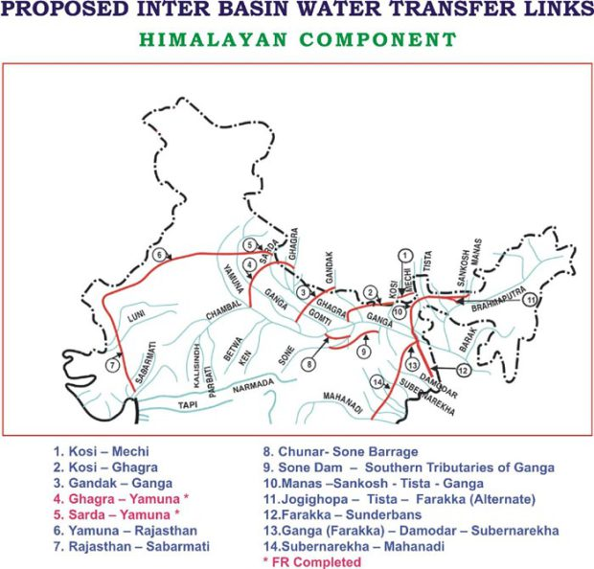

Slide 4
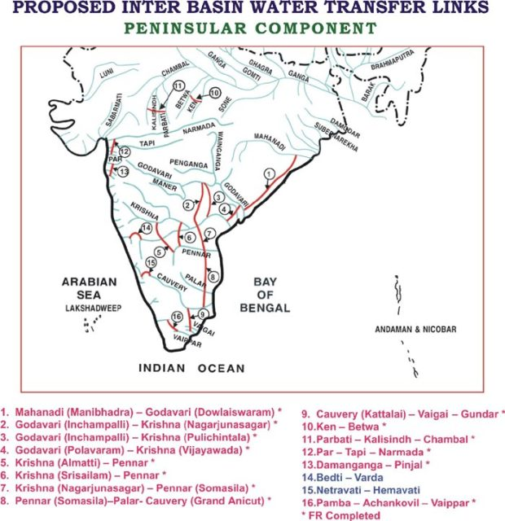

Slide 5
1) IF ALL THESE THINGS ARE SUCCESSFUL THEN INDIA CAN DEVELPOE LARGE NETWORK FOR INLAND WATER TRANSPORTATION OUT OF WHICH ABOUT 14,500 KM OF INLAND WATERWAYS WILL BE NAVIGABLE.
2) THE ECONOMY OF THE NATION WILL BOOST UP DECREASING THE LOAD ON RAILWAY AND ROADWAY.
3) MORE OPPERTUINITY FOR SMALL BOAT AND SHIP OWERS TO EXCEL
4) MARITIME SECTOR WILL FLOURISH AND GIVING BETTER OPPERTUINITY FOR INDIAN MARINERS.

Slide 6
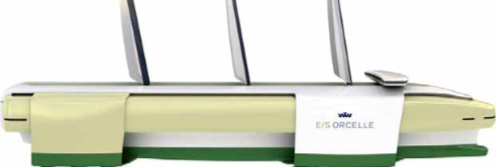
MODERN HYBRID INLAND WATER VEHICLES
ORCELLE
1) ORCELLE IS PROPOSED DESIGN BY WALLLENIUS WILHELMSEN’S WITH ZERO EMMISION.
2) THE E/S ORCELLE WILL HAVE FIVE HULLS; A LONG, SLENDER MAIN HULL AND FOUR SUPPORT HULLS PROVIDES STABILITY TO THE VESSEL.
3) THE STABILITY OFFERED BY THE PENTAMARAN HULL AND ITS FINS, COMBINED WITH THE USE OF NEW PROPULSION SYSTEMS, WILL ELIMINATE THE NEED FOR THE VESSEL TO TAKE ON AND RELEASE BALLAST WATER.
4) THE ORCELLE WILL HAVE TWO VARIABLE SPEED ELECTRIC PROPULSION SYSTEMS, KNOWN AS PODS, TO COMPLEMENT THE VESSEL’S SAIL AND FIN PROPULSION SYSTEMS EACH POD WILL HOUSE A MOTOR, GEARBOX AND PROPELLER IN A SINGLE COMPACT UNIT AND THIS PROPELLING SYSTEM IS COMMONLY KNOWN AS AZIPODE PROPELLER.
5) FOCUSES ON OPTIMIZING CARGO CAPACITY AND LOWERING ENERGY CONSUMPTION PER TRANSPORTED UNIT.

Slide 7
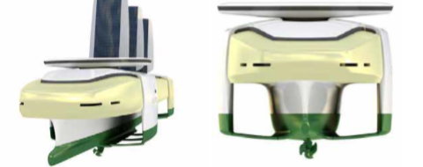
MATERIAL USED IN THIS DESIGN
THE LIGHTWEIGHT MATERIALS ARE USED ON THE PROPOSED IDEA OF THE SHIP LIKE ALUMINUM AND THERMOPLASTIC COMPOSITE MATERIALS AS THEY OFFER THEM DISTINCT ADVANTAGES OVER COMMON CARBON STEELS LIKE:
HIGH TENSILE STRENGTH
LESS MAINTENANCE
EASY TO SHAPE
LIGHTWEIGHT
FATIGUE RESISTANT
RECYCLABLE

Slide 8
CLEAN SAILING
SOLAR ENERGY
Solar energy will be utilized through photovoltaic panels located in the vessel’s sails. When not in use for propulsion, the sails may be tilted, laid down. The solar energy will then be transformed into electricity for immediate use, or for storage.
WIND ENERGY
Wind energy will mainly be utilized for propulsion directly through three sails constructed of lightweight composite material Capable of folding upward and outward, the rigid sails can rotate about the masthead to fix the best position to extract wind energy.
WAVE ENERGY
Wave energy may be transformed into various types of energy by combining the relative movements of the waves, total of 12 fins in all, enabling the vessel to harness and transform wave energy into electricity or mechanical energy The fins are also propulsion units.

Slide 9
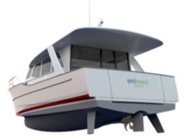
GREENLINE HYBRID DESIGN
SUPER DISPLACEMENT HULL
SUPERDISPLACEMENT HULL SHAPE GENERATES LESS DRAG, LESS WAKE, CREATES THE ABILITY TO USE LESS FUEL, GENERATES LOWER CO2 EMISSIONS, AND ENABLES THE USE OF (LIMITED) ELECTRIC POWER.
THE REDUCED ENERGY REQUIREMENT MEANS LESS RUNNING COST, LESS REFUELING STOPS
THE TWIN SACRIFICIAL STABILIZERS HAVE AN ADVANTAGE AS THEY DELIVER ROLL STABILITY, TRACKING STABILITY, AND PROTECT THE DRIVE AND RUDDER
IF THE STABILIZERS GET DAMAGED, THE STRUCTURE OF THE BOAT WILL NOT BE AFFECTED AND THE FINS CAN BE QUICKLY AND INEXPENSIVELY REPLACED

Slide 10
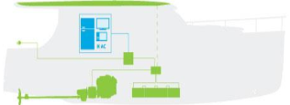
DRIVE SYSTEM
DRIVE SYSTEM CONSISIT OF :-
A SINGLE SWITCH TO CHOOSE BETWEEN THE 2 DRIVE MODES – DIESEL AND ELECTRIC
A FULLY ELECTRONICALLY MANAGED AND MAINTENANCE-FREE ELECTRIC MOTOR/GENERATOR (7 KW IN DRIVE MODE AND 5 KW IN GENERATOR MODE)
A HYDRAULICALLY OPERATED CLUTCH BETWEEN THE DIESEL ENGINE AND THE ELECTRIC MOTOR/GENERATOR
A 5 KW INVERTER/CHARGER DELIVERING AC 230 V POWER AT ALL TIMES
LIGHTWEIGHT AND COMPACT (SEVEN TIMES ) LIGHTER AND ONE THIRD OF LEAD BATTERY SIZE) THESE BATTERIES ARE RATED AT THOUSANDS OF CYCLES. WITH A LIFE EXPECTANCY OF 10 YEARS THEY REPRESENT THE BEST CHOICE FOR A HYBRID BOAT.

Slide 11
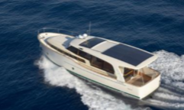
SOLAR ROOF
THE SOLAR ROOF ARRAY KEEPS THE BATTERIES FULLY CHARGED AND PROVIDES ADDITIONAL ENERGY FOR THE BOAT’S ELECTRIC DRIVE SYSTEM
NO-COST AND EMISSION-FREE SAILING IS POSSIBLE AT LOW SPEED WHERE THE AMOUNT OF ENERGY HARVESTED FROM THE SUN AND THE SYSTEM’S ENERGY CONSUMPTION ARE EQUAL
6 STANDARD PHOTOVOLTAIC SOLAR PANELS WITH FORCED AIR COOLING DELIVER UP TO 1.4 KW OF ELECTRIC POWER IN DAYLIGHT CONDITIONS.
AS THE SOLAR CELLS ARE PROTECTED AGAINST HAIL BY A 3.2 MM GLASS SHIELD AND ARE EASY TO ACCESS FOR CLEANING, IT IS CAPABLE OF SUPPLYING CONSTANT POWER TO ON-BOARD CONSUMERS LIKE THE REFRIGERATOR AND TVS AND CAN RECHARGE THE BATTERIES TO 100% WHEN EXPOSED TO A FULL DAY OF SUNLIGHT.

Slide 12
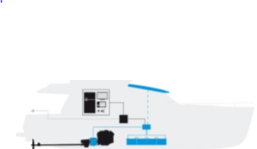
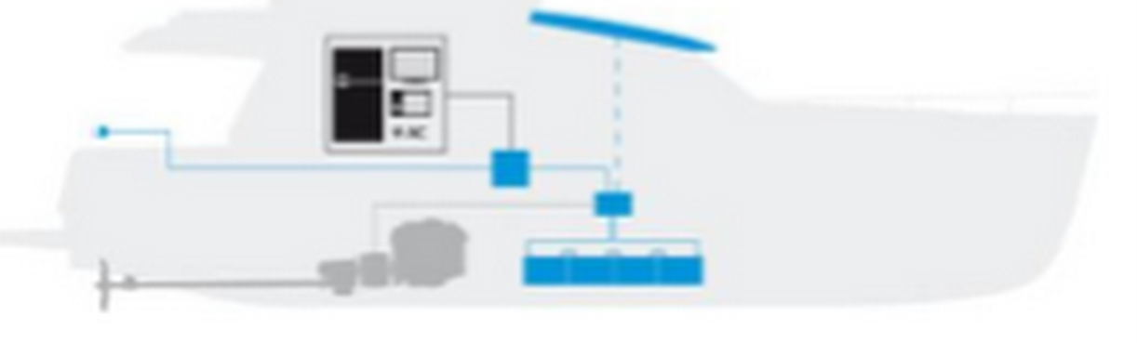

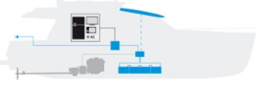
MODES OF OPERATION
The boat on the dockyard is plugged into the 230 V (120 V) AC shore power supply
The yacht is powered by the electric motor/ generator, which produces electric power
At anchorage the solar roof array charges the batteries, the diesel engine is switched on in order to drive the generator and charge the battery pack via generator
The diesel engine propels the boat and drives the generator, which recharges the battery pack.
AT DOCK
ELECTRIC DRIVE MODE
DIESEL DRIVE MODE
AT ANCHOR

Slide 13
SOME MORE LOW EMISSION & COST EFFECTIVE SOLUTIONS FOR INLAND WATERWAYS
TONBO SOLAR-ELECTRIC HMP FERRY, THIS CUTTING EDGE GREEN PASSENGER FERRY WILL INCLUDE A HYBRID MARINE POWER SYSTEM THAT WILL USE SPECIALLY DESIGNED SOLAR MODULE PANELS AND THE LATEST LITHIUM-ION BATTERY TECHNOLOGY.
THE TONBO WILL BE ABLE TO USE ENERGY COLLECTED VIA THE SOLAR MODULES TO CHARGE ON-BOARD BATTERIES TO REDUCE FUEL CONSUMPTION AND WILL ALSO BE ABLE TO RAPIDLY RE-CHARGE THESE BATTERIES BY USING SHORE POWER WHEN ALONGSIDE
ANOTHER INNOVATIVE SOLAR FERRY DESIGNED BY EMP IS THE MEDAKA ECO FERRY. THIS SMALLER SOLAR-ELECTRIC FERRY IS BEING DEVELOPED TO OPERATE AS AN ECO-FRIENDLY URBAN COMMUTER FERRY ESPECIALLY IN CITIES WHERE NOISE & AIR POLLUTION LEVELS ARE HIGH. IT IS ANTICIPATED THAT VESSELS LIKE THE MEDAKA WILL PLAY AN IMPORTANT ROLE IN MAKING URBAN WATER TRANSPORT NETWORKS MORE ENVIRONMENTALLY FRIENDLY.

Slide 14


Slide 15
CONCLUSION
APART FROM ALL THESE TECHNOLOGICAL ADVANCEMENTS AND PROPOSED HYBRID VEHICLES DESIGNED BY SOME SHIP BUILDERS THERE ARE MANY OPPORTUNITY TO DEVELOP NEW TECHNIQUES TO MAKE INLAND WATERWAYS ECOFRIENDLY AND SUCCESSFUL IN INDIA SO THAT WE CAN USE ALL THE NATURAL RESOURCES PROVIDED BY NATURE TO US TO GREAT EXTENT AND DECREASE OUR DEPENDENCE ON ROAD AND AIR WAYS AND SOLAR-ELECTRIC COMMUTER FERRIES WILL FULFIL AN IMPORTANT ROLE IN ENERGY-EFFICIENT CITIES NEAR HARBORS, BAYS AND WATERWAYS

Slide 16
THANK YOU
ANY QUESTIONS PLEASE

