Slide 1

TRANSTECH’15
THEME :
SUSTAINABLE INNOVATION
FOR
ENHANCING INDUSTRIAL GROWTH

Slide 2

HYBRID RENEWABLE POWER GENERATION
AND
THEIR APPLICATION IN SHIPPING INDUSTRY
“FOR A clean & BRIGHTER FUTURE!!!”

Slide 3


Slide 4
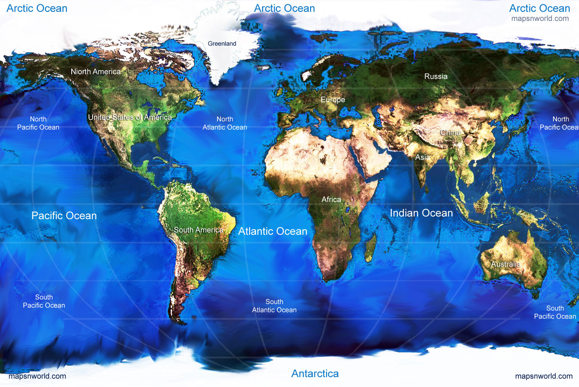

Slide 5

Why Marine Environmental
Protection?
HEALTH
HUMANS
LAND
OCEANS
“To ensure that the natural environment is conserved, enhanced and managed for the benefit of current and future generations, thereby contributing to sustainable development”.

Slide 6


Slide 7
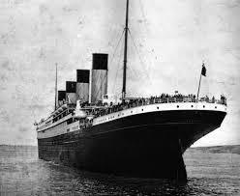
EFFICIENCY : 18 %

Slide 8
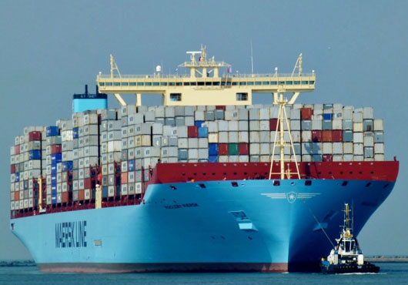
EFFICIENCY : 50%

Slide 9
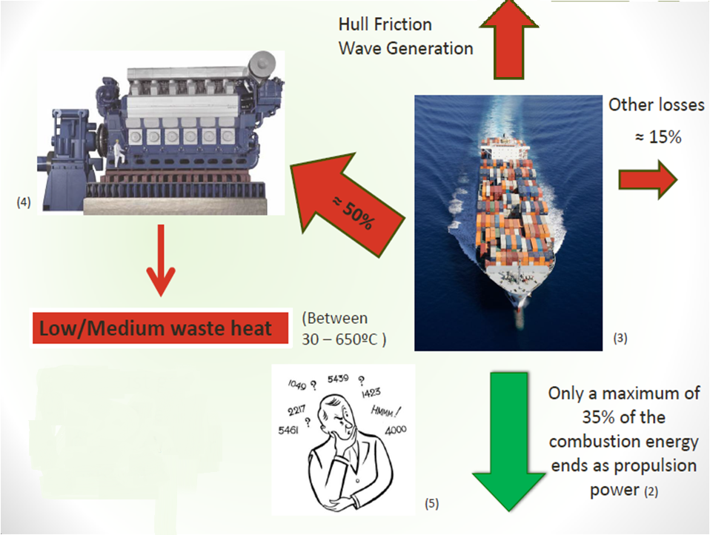

Slide 10

INTRODUCTION
The increasing interest in emission reduction
Ship operating costs reduction
Source of Waste Heat – Exhaust gas Energy
Possible electrical output of up to 11%

Slide 11
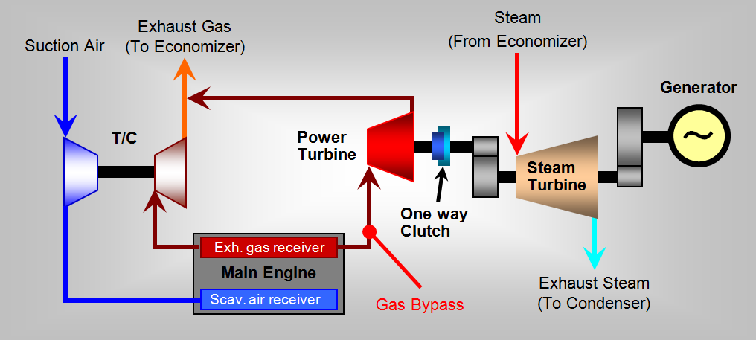
WHRS

Slide 12

WASTE HEAT RECOVERY SYSTEM
The Principle :- A part of the exhaust gas flow is bypassed the main engine turbocharger through an exhaust gas bypass.
Intake air and exhaust gas is reduced which results in an increased exhaust gas temperature after the bypass.
Hence there is an increase in the maximum obtainable steam production power that can be used in a steam turbine for electricity production.
The revised pressure drop in the exhaust gas bypass can be utilized to produce electricity by applying it to a power turbine

Slide 13
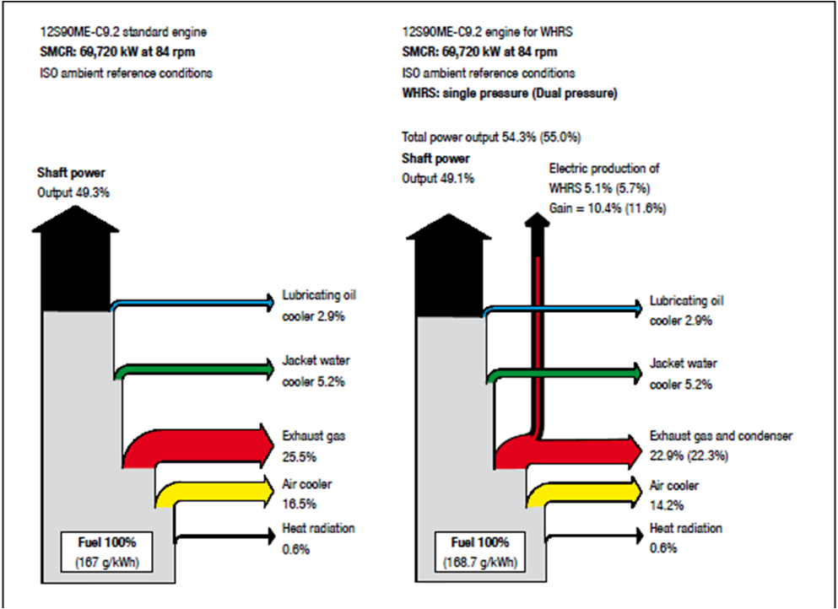

Slide 14

Choosing a system for a project depends on :
The ship’s running profile
The acceptable payback time
Space available
The power demand onboard the ship

Slide 15

DIFFERENT POSSIBLE SYSTEMS
Steam Turbine Generator
Steam Turbine-Power Turbine
generator
Power Turbine Generator

Slide 16
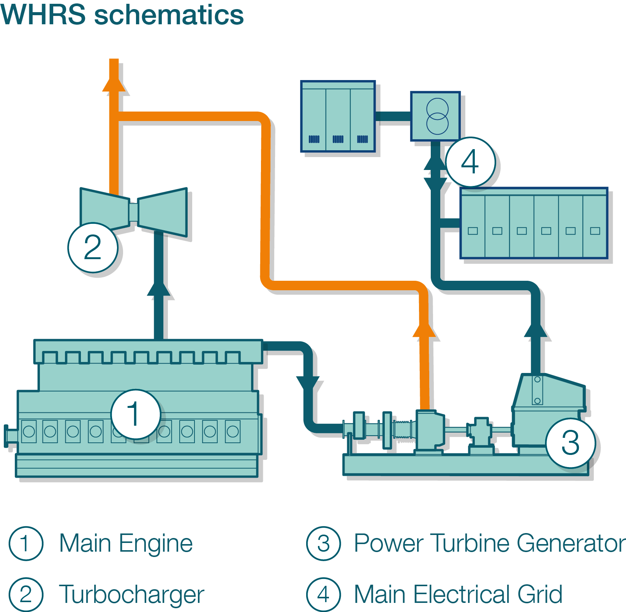
Power Turbine Generator

Slide 17

Power Turbine Generator
The simplest and cheapest system consists of an exhaust gas turbine
The power turbine is driven by part of the exhaust gas flow
The TCS-PTG WHRS solution offers both standalone and parallel running electric power sourcing
It will provide a 3-5% recovery ratio, depending
on the main engine size.

Slide 18
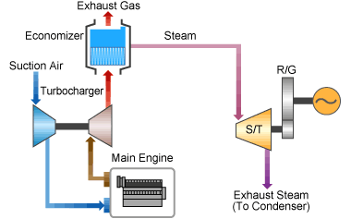
Steam Turbine Generator

Slide 19
Steam Turbine Generator
This system builds on the principle exhaust gas bypass.
The exhaust gas bypass stream is mixed with the exhaust outlet from the turbocharger , increasing the exhaust gas temperature before the boiler inlet.
This will increase the obtainable steam production power for the exhaust gas fired boiler.
It will provide a 5-7% recovery ratio, depending
on the main engine size.

Slide 20
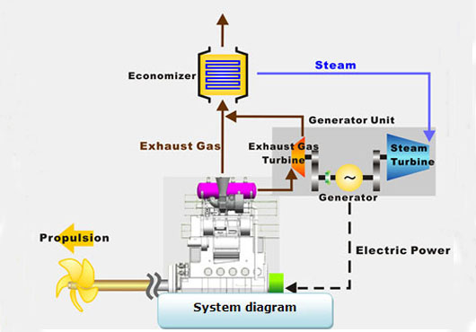
Power Turbine And Steam Turbine Generator

Slide 21
Power Turbine
And
Steam Turbine Generator
If the electric power demand on the ship is very high
The power turbine and the steam turbine is built onto a common bedplate via reduction gearboxes, connected to a common generator
By combining both steam and power turbines 8-11% power can be recovered, depending on the main engine size, engine rating and ambient conditions.

Slide 22
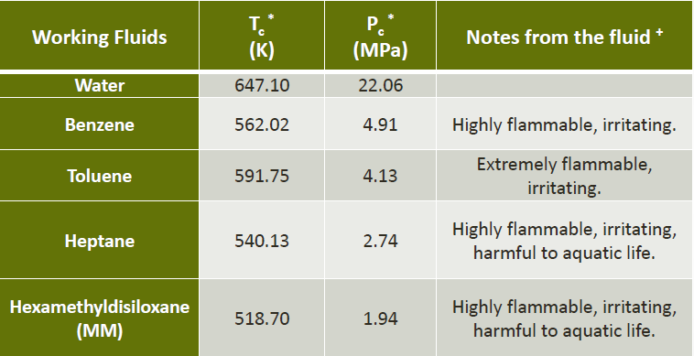
DIFFERENT WORKING FLUIDS

Slide 23
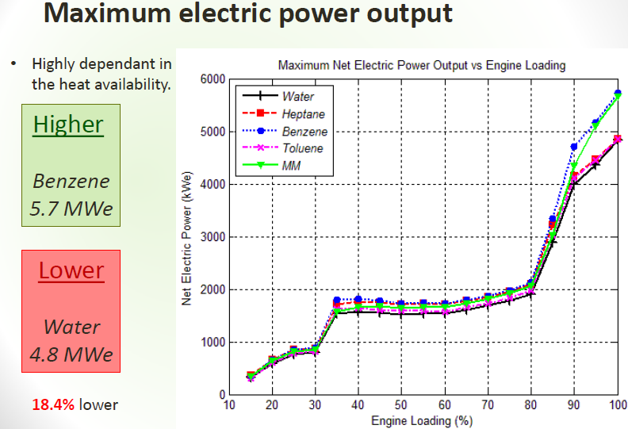

Slide 24
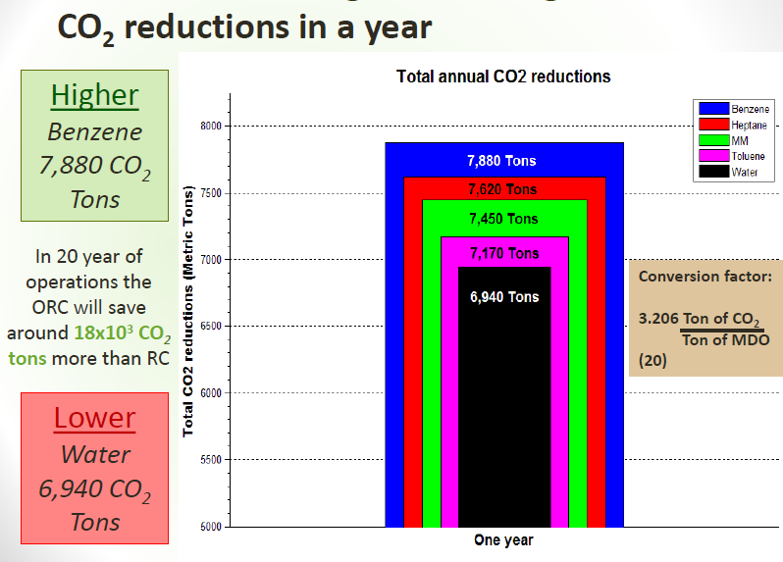

Slide 25

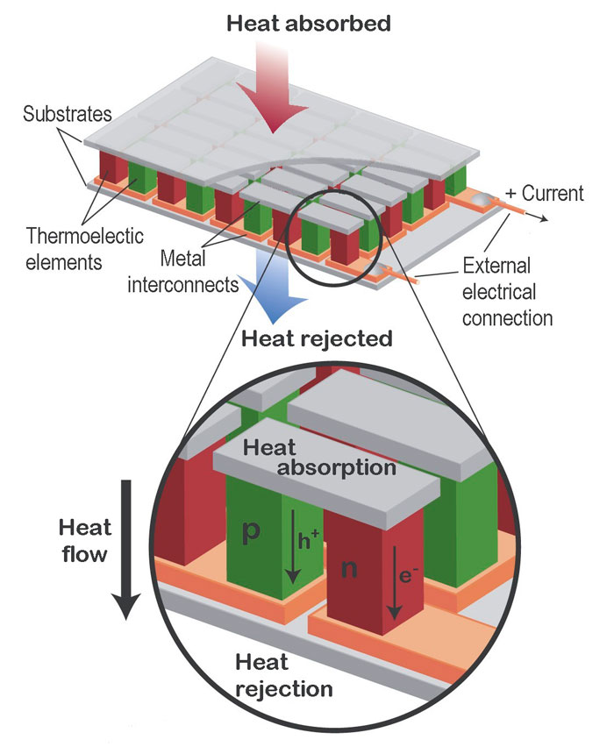
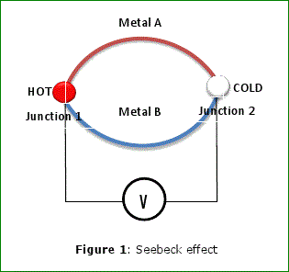
THERMOELECTRIC GENERATORS
These are generators which work on the ‘Seebeck effect’ principle, it states that a thermal gradient formed between two dissimilar conductors produces a voltage.
Thermoelectric materials
convert temperature differences
into electric voltage.

Slide 26
POTENTIAL FOR
THERMOELECTRIC GENERATORS ON BOARD
Marine Applications are not Sensitive to Weight and Size Constraints when as compared to other modes of transportation.
Heightened Port Restrictions and Engine Emissions Standards
Opportunity of reduce CO2 emissions (Green Technology).
Efficiency Improvements are of Critical Importance to Industry.

Slide 27
POTENTIAL FOR
THERMOELCTRIC GENERATORS ON BOARD
Waste-heat recovery with thermoelectric power generators can improve energy efficiency and provide distributed electricity generation.
New thermoelectric materials motivate development of thermoelectric generators for numerous applications with excess exhaust and process heat systems.

Slide 28

ADVANTAGE OF MARINE INDUSTRY
Has the greatest consistent temperature differential (Exhaust and Sea Water).
Lesser limitations on weight and space.
Has a high potential of waste heat recovery locations.
The ability to retrofit every vessel easily regardless of use of conventional waste heat recovery .

Slide 29
INNOVATION FOR FUTURE SHIPS

Slide 30
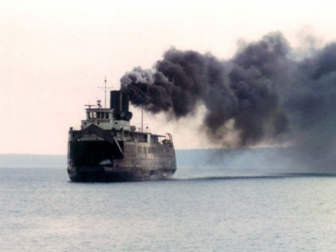
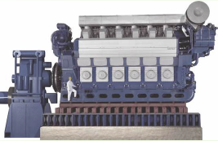
PROPOSED SYSTEM
CO2 STACK GAS RECOVERY PLANT
CO2
REFRIGERANT
SYSTEM
FIXED FIRE FIGHTING
A/C

Slide 31
PROPERTIES OF THE CO2 USED:
LOW TOXICITY
NON-FLAMABILITY
ZERO OZONE DEPLETION POTENTIAL
VERY LOW GLOBAL WARMING POTENTIAL
EXCELLENT THERMODYNAMIC PROPERTIES

Slide 32

CONCLUSION
Lower ship operational costs
Lower total fuel consumption of
the ship
Reduction of CO2 emission
Thermoelectric Power Generation is promising for applications in the Maritime Industry

Slide 33


NOW LET’S WORK TOGETHER,
TO HAND OVER A CLEAN FUTURE
TO OUR NEXT GENERATION!!

Slide 34
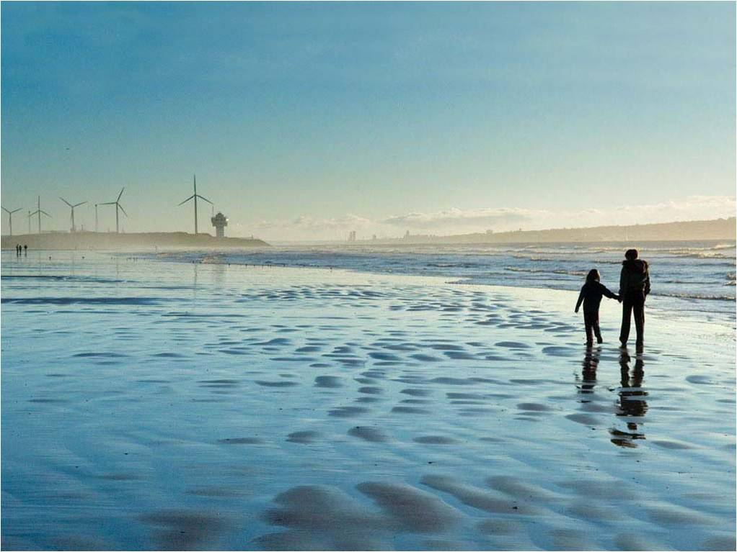
JINTU
KESHAV
Thank you ☺!!!!
PRESENTED BY:
RAM
KURUVILLA

Slide 35

ANY QUERIES?

