Slide 1
Improved Collision Safety of Ships by an lntrusion -Tolerant lnner Side Shell
By,
DICKSON A
BALAMURUGAN S
YEZDI J GHADIALI

Slide 2
Reasons for Improved Safety
Fatalities
Property
Cargo
Pollution

Slide 3
Statistics of Collision Damage
IMO’S project - Harmonization of Rules and Design Rationale (HARDER)
Total Casualties > 2900
Collision – 1851
Groundings – 930
Other incidents – 165

Slide 4
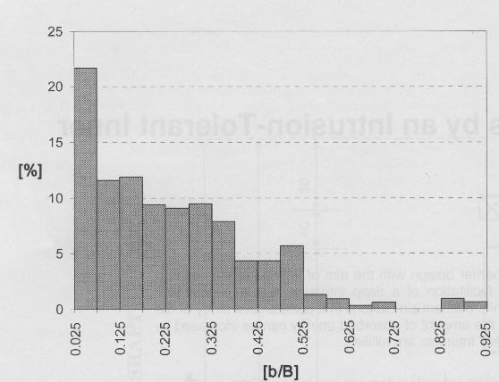
Figure shows a distribution of the depths based on the statistics from 570 collision events.
The intrusion depth b, is normalized by ship’s breath B as b/B.
The mean intrusion depth is 0.15 x B , In double side shell is approximately 0.05 to 0.15 x B
80% of the area collided is above the water line.
20% of the vertical damage is below the water line.
Hence the upper side shell plays an important role in energy absorption during collision.

Slide 5
Collision Mechanism
External Collision Mechanism
  Rigid Body
  Global Motions of the Ships
  Hydrodynamic forces
Parameters of External Collision Mechanism
  Mass striking and struck ship
  Velocity of striking ship and struck ship
  Collision location
  Collision Angle
It determines the kinetic energy dispersed into the structures in the collision
Internal Collision Mechanism
  The Way the Kinetic Energy is Absorbed through
    Buckling
    Crushing
    Tearing
    Shearing
    Friction
  Striking bow geometry, Structural Arrangement of the Struck Ship
  Material Properties

Slide 6
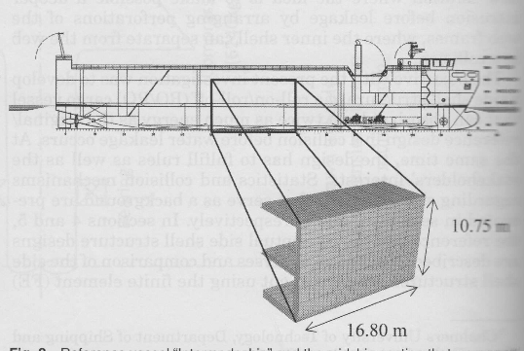
Reference Ship and Side Shell Structure
Ships name – INTERMODESHIP
Type – RO/RO
Length overall (LOA) – 88m
Breadth (Molded) – 13.3m
Design draught – 4m
Cargo capacity 48 trailers or 1700 DWT

Slide 7
Conceptual design of the deformable inner barrier:
To become a commercial success,The main requirements for a new double side shell design should be.
    A l00% increase of the energy-absorption capability of the side shell structure.
    A cost increase of a maximum of 1.5% of the ship's total cost.
    A weight increase of a maximum of 1.5% of the ship's total lightweight.
    An unchanged cargo and ballast volume.
    Normal structural strength according to the rules.
    Access for inspection and maintenance.
    Not "too complicated" design to construct.

Slide 8
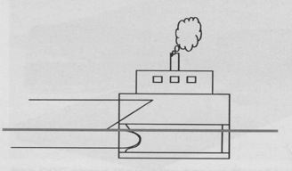
View of the Deformable Inner side shell barrier

Slide 9
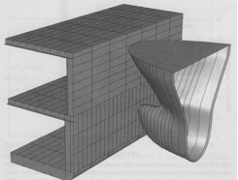
Finite element models and calculation procedures:
The FE simulations were carried out by Ulf B. Karlsson.
Software used ABAQUS/Explicit version 6.5
System Configuration - Intel Xeon DP 3.2 GHz 800/1M processor with a 1 GB DDR333 internal memory.
For the FE calculation the midship section of the ship was used.
Calculation was done using
  1. Normal Steel – yield strength 240Mpa
  2.High tensile steel – yield strength 700Mpa
Velocity of the ship – 10m/s

Slide 10
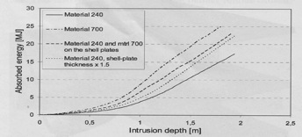
FE analysis of reference structure: material, shell-plate thickness, and energy absorption:
The Chart shows how the Energy is absorbed as the intrusion depth is increased for both
High strength steel with a yield stress of 700 MPa
Normal ship-steel grade with a yield stress of 240 MPa
The energy absorption was increased from 17.3 to 24.9 MJ, or with 44%
Applying the high strength steel only to the side shell plates, keeping the normal grade steel for the other structural members, the increase of the absorbed energy to be 33%

Slide 11
Comparison between the Reference design and The deformable inner barrier design
The collision resistance and energy absorption of the reference and the conceptual design with the deformable inner barrier were compared by simulating 10 collision events.
The bow collided at an angle of 90 deg with the fore tip of the bulb striking either (A) between two web frames, or (B) into a web frame

Slide 12
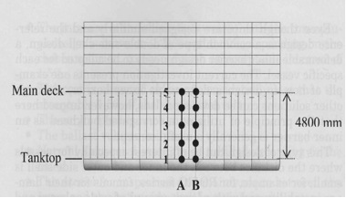
Points to Note
The bulb strikes between two web plates (A) in the middle between the main deck and the tanktop (3)
The intrusion depth for the reference design was 1.94 m, while it was increased to 3.46 m for the deformable inner barrier design – increasing the energy absorption from 17.3 to 59.2 MJ, or 242%.

Slide 13
An increase of 278% is noted when the bulb strikes at the point A1 until the inner shell is penetrated below the main deck for reference and conceptual design.
Depth increase is from 1.74m to 3.52m
The energy absorbed is increased from 24.1MJ to 91.2MJ

Slide 14
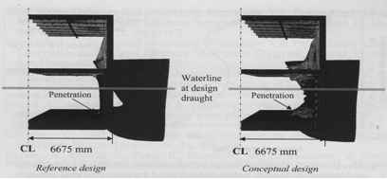

Slide 15
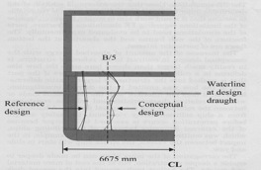
Conclusion
The intrusion depth of the reference design was 1.50 to 2.04 m i.e. design would cope with 18% to 29% of all collisions without penetration through the double side shell.
The depth is now ranged between 2.98 to 3.96m i.e. it can cope between 40 to 60% of collision without penetration of double side shell.

Slide 16
The increase of ship's lightweight with the conceptual design between 0.21% and 0.60%, depending on the chosen solution, compared with an acceptable increase of 1.5%.
The cost is assessed as being considerably less that the acceptable 1.5% of the ship's total cost.
The cargo space is unchanged.
The ballast volume is intact.
Normal structural strength is fulfilled according to the rules.
The access for inspection and maintenance between the inner and outer side shell is maintained.
The design is not considered "too complicated" to construct at a normal shipyard.

Slide 17
THANK YOU

