Slide 1


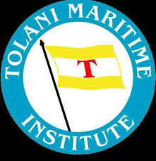
Tolani Maritime Institute
8-9 March 2019
Pune
TransTech 2019
International Technical Seminar on Transportation Technology
Theme
“Advancement in Technologies for Sustainable Transportation”

Slide 2
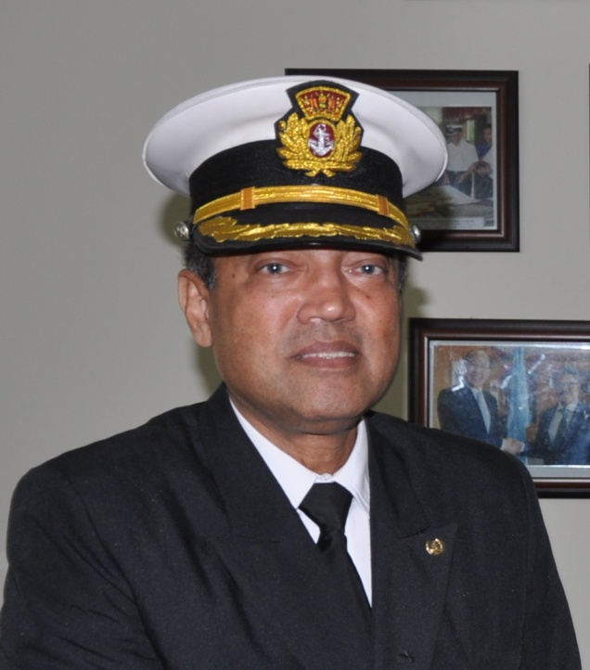

Future Ships
---
changing faces of the
oceans!
SAJID Hussain CEng CMarEng FIMarEST
Commandant, Bangladesh Marine Academy
Governor, Board of Governors, WMU Sweden
IMO Maritime Ambassador
Council Member, IMarEST London

Slide 3
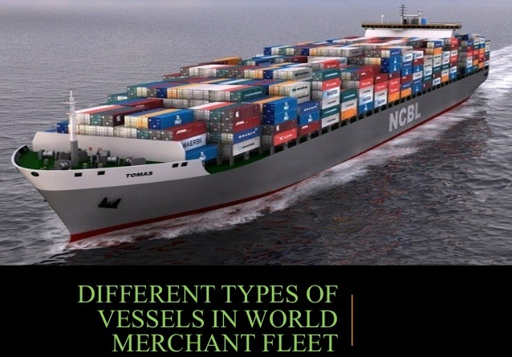
World Fleet
50,000 merchant ships trading in International Voyages.
Every year 62.7 trillion ton-miles* of cargo are transported around the world.
*Ton-mile is the unit of freight transportation. One ton of goods carried one mile, as a unit of traffic.

Slide 4

IMO SecGen Dr. Kitack Lim
said during launching of the report ‘Transport 2040: Automation,
Technology and Employment - the Future of Work’
How will the seafarer of the future manage the challenges related to an increasing level of technology and automation in maritime transport?
How will the new technologies impact on the nature of jobs in the industry?
What standards will seafarers be required to meet with respect to education, training and certification to qualify them for the jobs of the future?”
An important strategic direction for IMO is the integration of new and advancing technologies into the regulatory framework

Slide 5
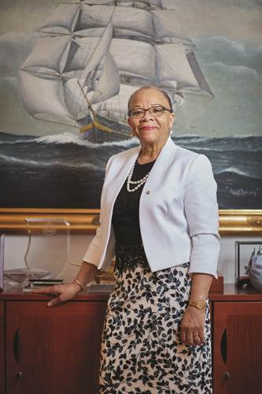
WMU President
Dr. Cleopatra Doumbia-Henry
said in the new report ‘Transport 2040: Automation, Technology and
Employment - the Future of Work’
Transport provides a vital service to the national economy and the global community. Innovation and technology have always been part of its development and have enabled transport to become a driver for industrialization, globalization and development.
It may lead to a reduced demand for workers of a certain profile and may create new demands for workers with different qualifications.

Slide 6
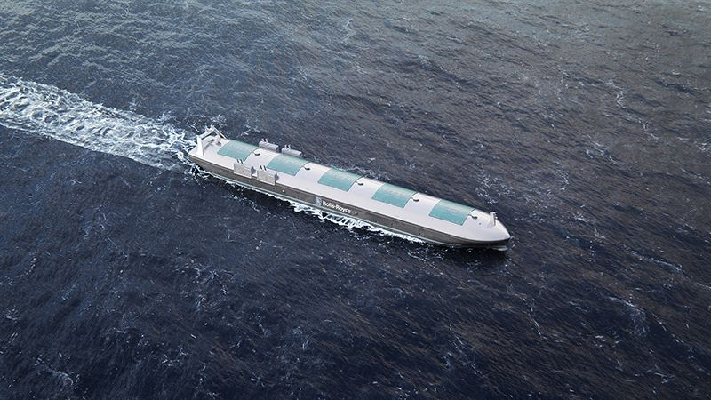
Introduction
Currently the ship designers on the desk are busy inventing self-driving, remotely-operated and crewless vessels. Not far beyond that we will be surrounded by new hi-tech presence like self-driving car and robotic ships.
Wind-powered drones may circle the ocean for recording climate and current data. Can the ocean-going ships be left aside!
Ships are already using navigation assistance; will receive more robotic control.

Slide 7
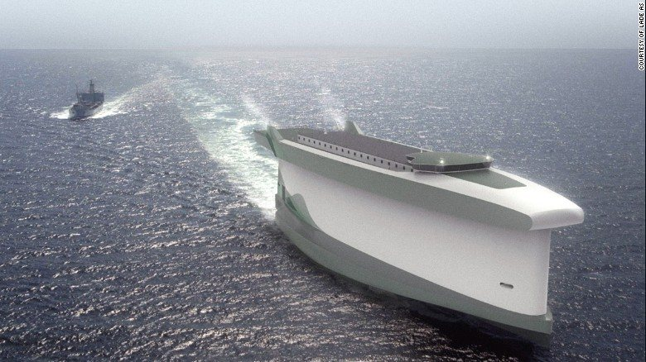
Autonomous/Crewless Ships - 1
Crewless means elimination of the quarters, mess, stairs, doors and just about everything needed for habitation.
Loads of extra space available for more cargo. Another advantage will be a more streamlined exterior; weight balance will be ensured easily.
You can take away the superstructure, redistribute the weight and necessity of ballast will be reduced.

Slide 8
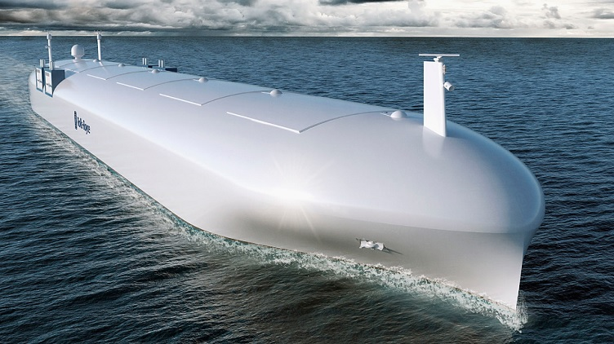
Autonomous/Crewless Ships - 2
Elimination of HVAC (heating, ventilation, and air conditioning), food and water, and other life-sustaining systems is another advantage, reducing the cost while increasing the cargo space.
Absence of humans means no one on-board to fix anything; reliability, redundancy of various systems and predictive maintenance will be needed.
Ships will have 2/3/4 propellers. Diesel fuel will be replaced by LNG. Unmanned engine room will not have any oxygen to ensure fire-proof environment!

Slide 9
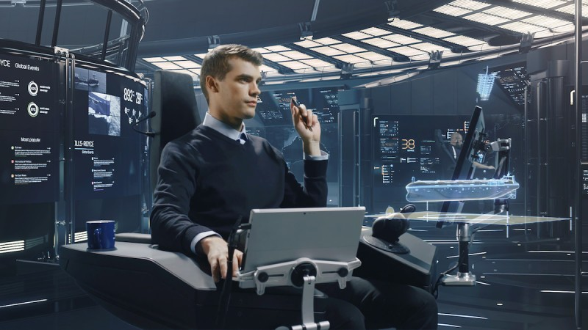
Wärtsilä Experiment
In Aug 2017, in San Diego, California: an engineer with a joystick, linked via satellite, piloted a massive cargo ship thousands of miles away off the coast of Scotland.
Wärtsilä believes that smarter ships of the future will allow ship-owners to more capably control the movements of their vessels, reduce fuel consumption and lower emissions.
Undoubtedly, it’s an ambitious initiative to tackle a grand challenge of the 21st Century.
Shipping is a massive industry, but it is not known for being the most hi-tech.

Slide 10
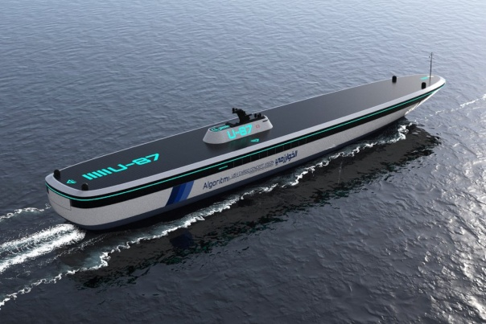
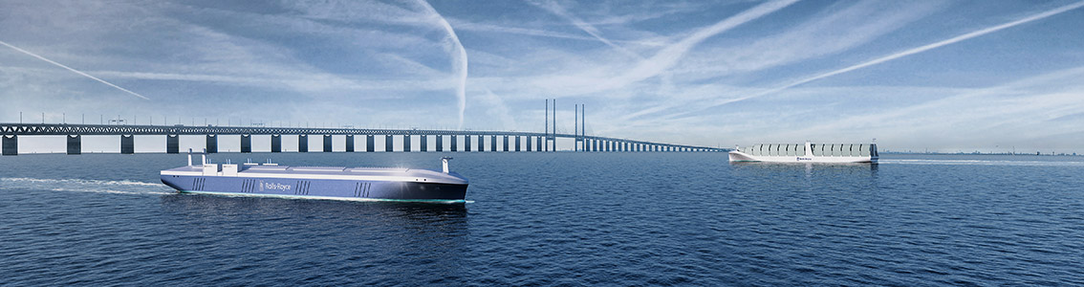
Autonomous vessels
Three primary possible opportunities:
autonomous control or self driving,
remote operation, similar to piloting a drone and
reduction or elimination of crews.
A ship on the open sea will be controlled by an onboard computer, with the occasional oversight of a land-based operator who may manage hundreds of different ships at once.
As it comes to port, or enters a congested area – a remote operator could take full control or a crew could boat out and board.

Slide 11
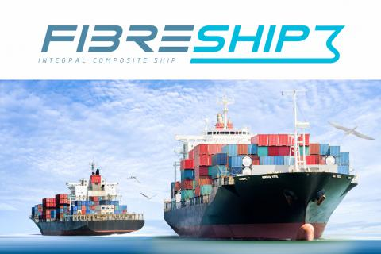
Future Ships control – Human or Robot
Human or robot, the design is set to change; hull materials might be glass fibres and plastic >> reduction of weight (Ref: EU Project – Fibreship).
3D printing – a solution for producing ship components. If a part breaks at sea, on-board 3D printing might be an attractive prospect for owners of some of the world’s largest ships.

Slide 12
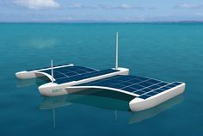
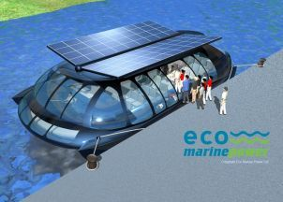
Alternate – Solutions
A low-tech solution from the Maersk has already discovered that it can cut fuel use 30% simply by steaming more slowly.
More slender ship designs alone could reduce fuel and emissions – through 10-15% at slow speeds and up to 25% at high speeds.
Japan’s Eco Marine Power is working on rigid sails featuring solar panels.

Slide 13
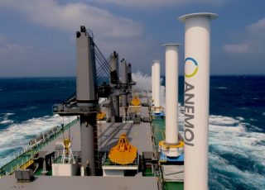
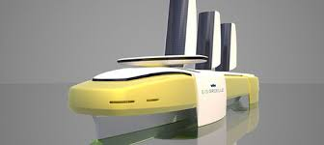
Alternate – Solutions
Flettner rotor-fitted ultramax wins
ship-of-the-year award
Japan’s NYK boasts that its design for a 350m-long container ship – the Super Eco Ship 2030 – would use LNG to make hydrogen to run fuel cells.
Scandinavian Wallenius Wilhelmsen with E/S Orcelle – a lightweight cargo ship designed to transport up to 10,000 cars (electric, we trust) on 8 decks; would be powered by electricity – half from wind, solar and wave energy, & other half from converting some of that energy into hydrogen to power fuel cells. The company says the ship could be afloat by 2025.

Slide 14
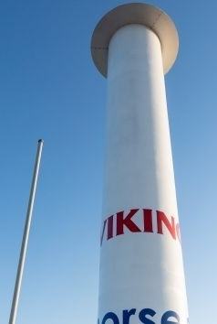
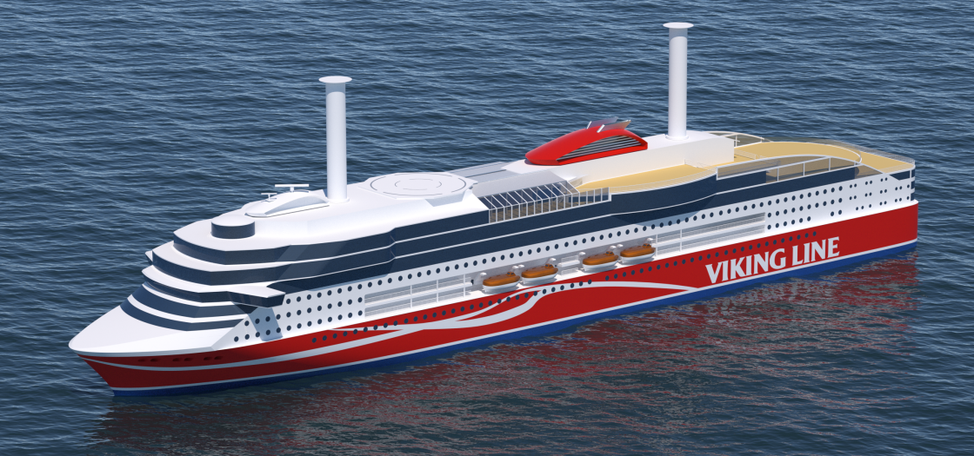
Alternate – Solutions
A new generation of giant cruise ships powered this way and carrying up to 7,000 passengers will be launched by MSC Cruises starting in 2022.
First LNG-powered cruise ship Viking Grace – operating between Finland & Sweden. It is first ship-based “rotor sail” to capture power from the wind. Rotor sails have a large spinning cylinder amidships. Wind hitting the rotor creates a vertical force that can be used to power the ship, a phenomenon known as the Magnus effect.

Slide 15
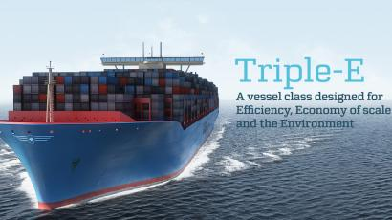
10 Future ocean-going Ships
1. Maersk’s Triple E- Vessels
When the 18,000 TEU Triple-E container ships roll out in the market, they would be the biggest container ships in the world, featuring the finest green technologies with massive size. These huge eco-friendly monster ships are sure to revolutionize the shipping industry.

Slide 16
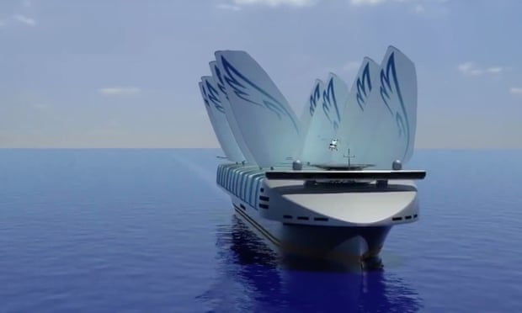
10 Future ocean-going Ships
2. NYK’s Eco Ship 2030
NYK’s Eco Ship 2030 is a bold ship concept, which will take modern ship building to an all new level. Consisting of all types of Eco-friendly technologies that you can think of, the Eco Ship 2030 will run on fuel cell technology along with solar cells and wind sails. A green ship can’t get better than this.

Slide 17
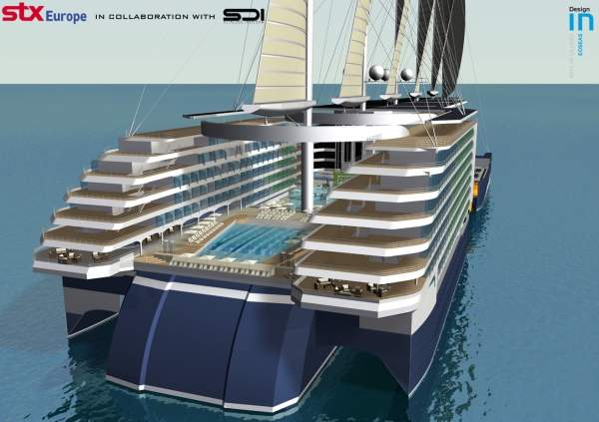
10 Future ocean-going Ships
3. STX Europe’s Eoseas
Eoseas is a five hulled pentamaran cruise ship concept by STX Europe. The ship would use LNG-Diesel, Solar and Wind energy to reduce fuel consumption level. The vessel has an aim of reducing power consumption by 50%.

Slide 18
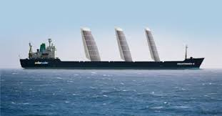
10 Future ocean-going Ships
4. Eco Marine Power’s Wind-Solar Ship
The Eco Marine Power’s green ship project has been in the news for quite some time now. Supposed to be the first ship which would use rigid sails with photovoltaic cells, the Eco Marine Ship is surely one of the most promising future ships.

Slide 19
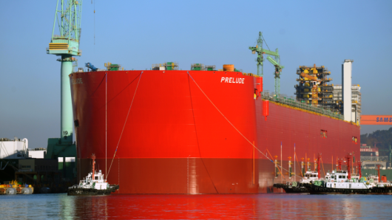
10 Future ocean-going Ships
5. Shell’s FLNG – The Largest Floating Structure in the World
Shell is developing a Floating Liquefied Natural Gas Facility, which when complete in 2017, will be the world’s first FLNG development and also the largest thing to float on the oceans. Though not technically a ship, this FLNG needs to be in the list for all the hype it has generated.

Slide 20
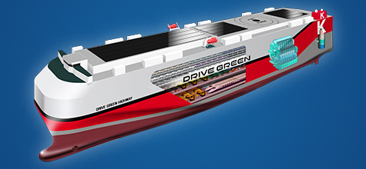
10 Future ocean-going Ships
6. Kawasaki Kisen’s Futuristic Car Carrier
The futuristic, next generation Kawasaki’s Kisen’s car carrier is one great ship, not just for its design but also for its “green quotient”. The ship intends to cut carbon emission by 40% and will be capable of carrying 2000 cars.

Slide 21
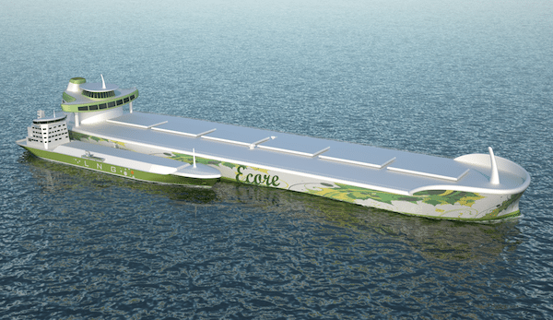
10 Future ocean-going Ships
7. DNV’s Ecore
A concept launched together by FKAB, TGE Marine, Cargotec, and MAN Diesel & Turbo (DNV), ECore is a Very Large Ore Carrier (VLOC) which would not only lower the fuel costs and emissions but also improve the loading efficiency.

Slide 22
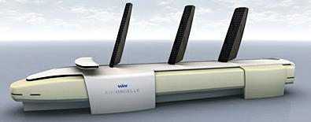
10 Future ocean-going Ships
8. WalleniusWilhelmsen Logistics’ E/S Orcelle
Wallenius Wilhelmsen Logistics’ E/S Orcelle is a concept of world’s first zero emission vessel. You heard it right – ZERO emission. The E/S Orcelle, which is still under development with the Wallenius Wilhelmsen group, is slated to launch in the next 20 years, with the advent of renewable energy resources taking over – around 2025.

Slide 23
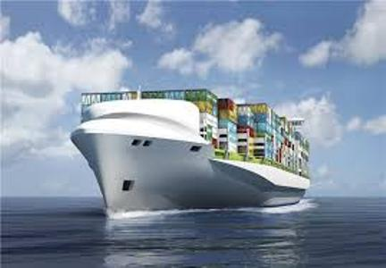
10 Future ocean-going Ships
9. DNV’s Triality
DNV’s Triality is an eco-friendly Very Large Crude Carrier (VLCC) concept which aims at emitting 34% less carbon dioxide. Triality concept will make use of the dual fuel slow speed engines and will not require any ballast water.

Slide 24
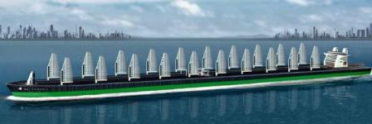
10 Future ocean-going Ships
10. Sauter Carbon Offset Design (SCOD)’s Green Tanker – 75% Reduction of Harmful Emissions
Sauter Carbon Offset Design (SCOD) unique tanker vessel concept aims very high reduction percentage of the noxious greenhouse gases – up to 75%. The cargo vessel will utilize Liquefied Natural Gas (LNG), sails and solar energy as fuelling sources. The ship is expected to offer long term benefit in terms of cost and utility efficiency.

Slide 25
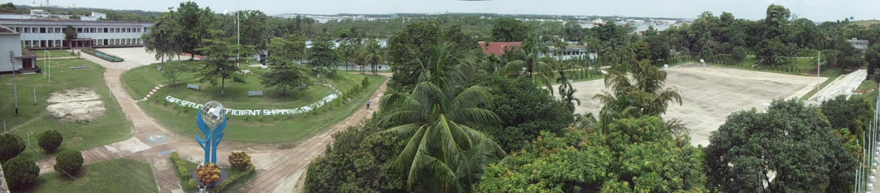
Aap sabko bahut bahut
dhanyavaad!
Bon Voyage!

