Slide 1
Communication at sea
By Abhishek Kumar
Vikrant Sharma

Slide 2
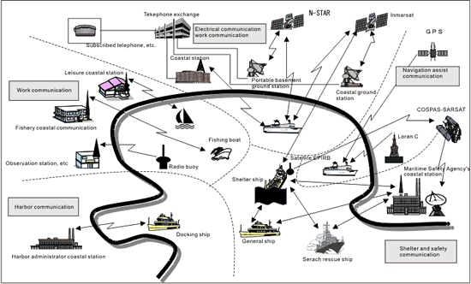
CONCEPT OF MARITIME COMMUNICATION

Slide 3
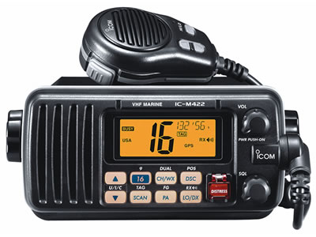
MARITIME COMMUNICATION
MARINE VHF
enables ship-to-ship communication, communication with leisure-purpose coastal stations, the receipt of navigation alerts and weather information, communication with the Maritime Safety Agency in emergency, and communication with large vessels
Uses a part of the frequency of the International VHF.

Slide 4
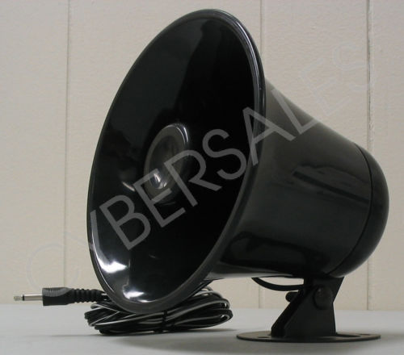
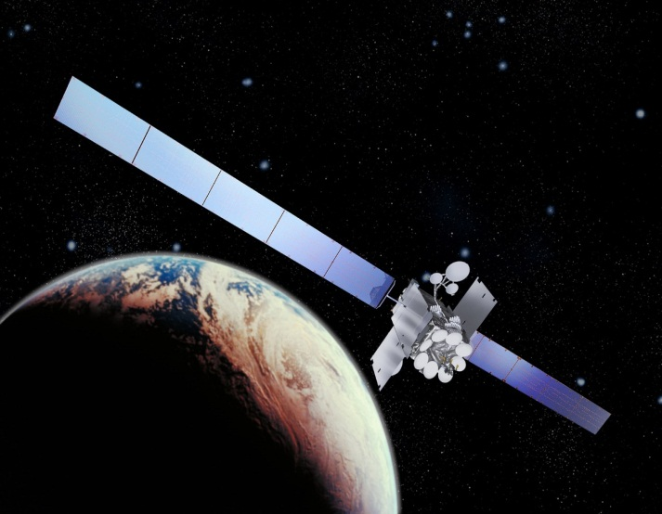
MARINE COMMUNITY HORN AKA FISHERY AREA INFORMATION SYSTEM
INMARSAT MOBILE SATELLITE COMMUNICATION
In operation as a worldwide maritime satellite communication system
MARINE COMMUNITY HORN
INMARSAT

Slide 5
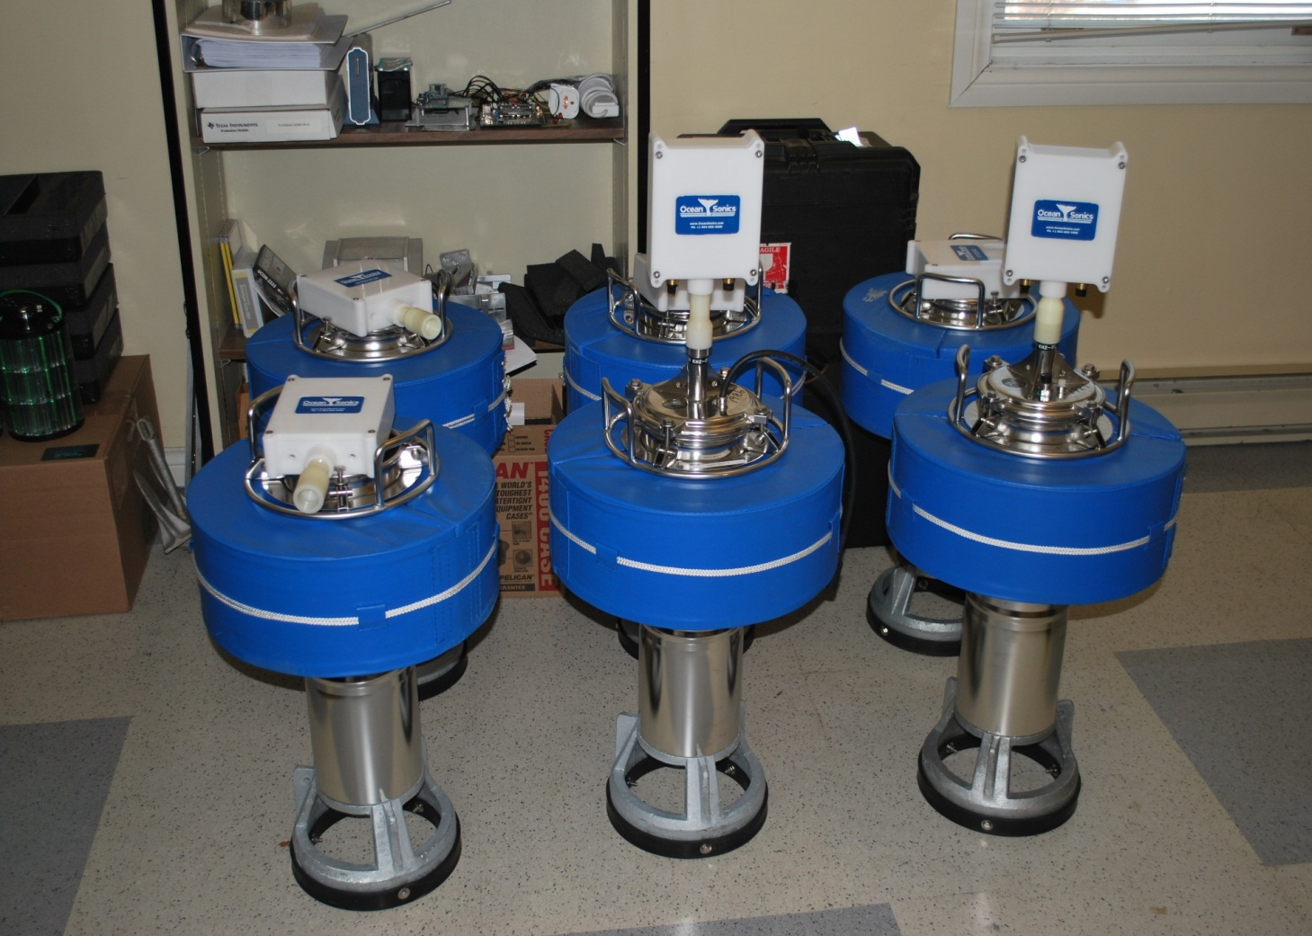
BUOY
This is a system that targets a buoy with in-built wireless equipment to receive radio waves emitted from there and measure their direction between the ship and other points
RADIO/BUOY

Slide 6
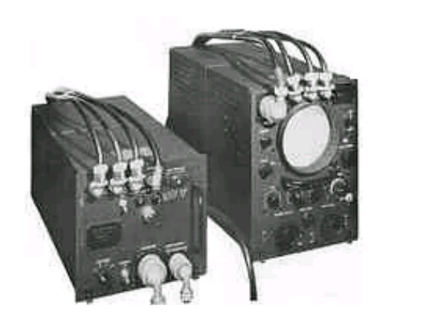
NAVIGATION ASSIST RADIO SYSTEM
1. Loran C

Slide 7
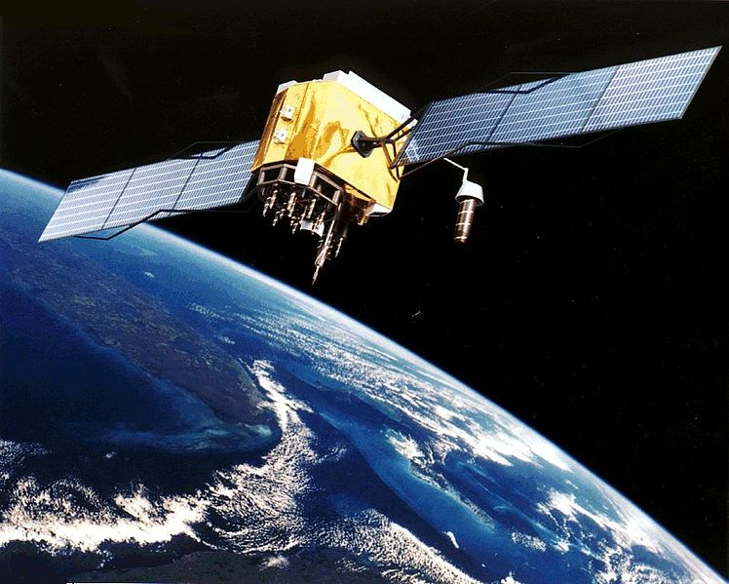
2. Satellite Navigation Equipment (GPS)
GPS

Slide 8
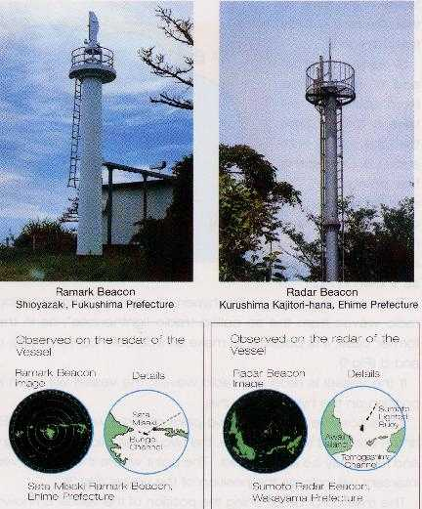
3. RAMARK Beacon

Slide 9
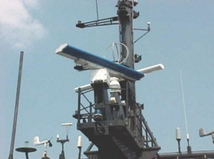
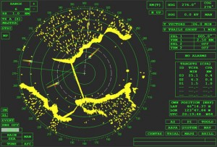
4. Vessel Radar
RADAR
PPI

Slide 10
Global Maritime Distress Safety System
Basic concept of GMDSS is that search and rescue authorities ashore, as well as shipping in immediate vicinity of the ship in distress, will be rapidly altered to a distress incident so that they can assist in a co-ordinated SAR operation with the minimum delay. The system also provides urgency and safety communication.

Slide 11
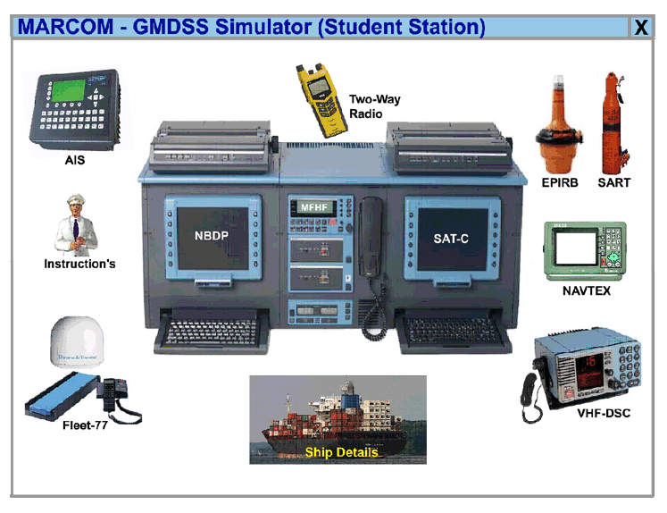
GMDSS

Slide 12








INNOVATIVE MEANS
Smartphone apps for communication on ships
Innovative Data Compression Algorithms to Increase System Throughput Efficiency on Navy Ship-to-Shore Communication Networks
Ships do have a few tricks they can use to improve Wi-Fi connection sometimes by installing two devices : a proxy and a package shaper.
Maersk Line and Ericsson bring mobile connectivity to the oceans
ONAIR to launch full mobile phone connectivity for Hapag Lloyd, ONAIR provides GSM and Wi-Fi across the globe
People can now remain in touch in the most remote corners of the world

Slide 13
NYK’s IBIS (Innovative Bunker and Idle-time Saving) project which helps improve the operation of their ships and reduce CO2 emissions, requires delivering real-time weather and sea current forecasts to the ship and automatically sending ship operation data back to shore for on-going analysis.
Cloud computing era
Idea of a new app store
Wi-Fi Routers near coastal regions

Slide 14
THANK YOU
Questions?

