Slide 1

Curtailing the negative effect of merging Swarm Intelligence with Nanotechnology.
Suhel Shariph
Arnav Sharma
Dhruv Bindal

Slide 2
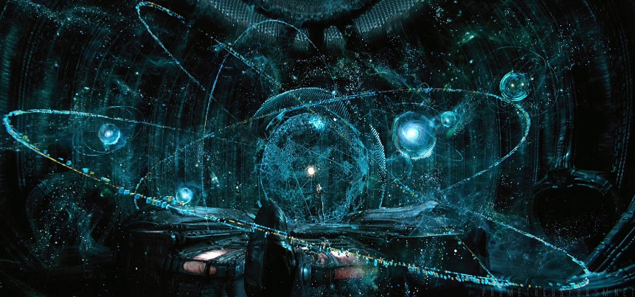
The VISION 2040
A vision is something seen in a dream, trance, or religious ecstasy, especially a supernatural appearance that conveys a revelation. Visions generally have more clarity than dreams, but traditionally fewer psychological connotations.
Vision describes our dreams, hopes and ambitions; our most radical conception of our organization and community—20, 50, 100 years from today. It stands in contrast to the mission statement, which aims to be more realistic description of the current state.
2040….a world which will be far more advanced than the today’s world. Till 2014, we have developed certain scientific theories that could minimise the human labour and increases the accuracy and precision in various operations but till 2040 the vision will be completely different.

Slide 3
Vision for the future
Vision is the ability to imagine what a society or an industry could develop into in the future and to plan it in a suitable way.
We, by this presentation are looking forward to visualize a world that is much more comfortable to live in because of the assistance provided by the combination of nano technology and swarm intelligence.

Slide 4
Nano Technology
Nanotechnology is the manipulation of matter on an atomic and molecular scale. The earliest, widespread description of nanotechnology referred to the particular technological goal of precisely manipulating atoms and molecules for fabrication of macro scale products.
The Nano technology as stated earlier is a very vast field of sciences. It is also a very upcoming field and is readily serving the common means of science. Now, to have a little more clarification of the reason for stating the Nano-technology here, we have one more concept which curtails the importance of nanotechnology: --- The Swarm Intelligence...

Slide 5
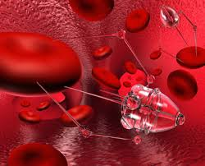
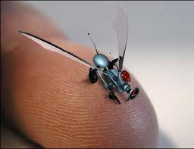

Slide 6
Swarm Intelligence
Swarm intelligence is the collective behavior of decentralized, self-organized systems, natural or artificial. The concept is employed in work on artificial intelligence.
Artificial intelligence is the theory and development of computer systems able to perform tasks normally requiring human intelligence, such as visual perception, speech recognition, decision-making, and translation between languages.

Slide 7
Algorithms of Swarm Intelligence
Anti Colony Optimization Model
Particle Swarm Optimization Model

Slide 8
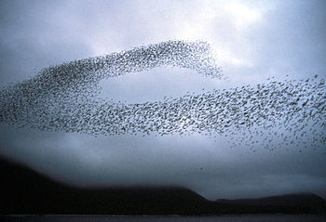
Examples of swarm intelligence algorithms
Flocking OF BIRDS
Notes:
Swarm behaviour, or swarming, is a collective behaviour exhibited by animals of similar size which aggregate together, perhaps milling about the same spot or perhaps migrating in some direction. As a term, swarming is applied particularly to insects, but can also be applied to any other animal that exhibits swarm behaviour. The term flocking is usually used to refer specifically to swarm behaviour in birds, herding to refer to swarm behaviour in quadrupeds, shoaling or schooling to refer to swarm behaviour in fish. Phytoplankton also gather in huge swarms called blooms, although these organisms are algae and are not self-propelled the way animals are. By extension, the term swarm is applied also to inanimate entities which exhibit parallel behaviours, as in a robot swarm, an earthquake swarm, or a swarm of stars

Slide 9
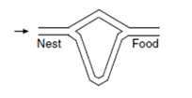
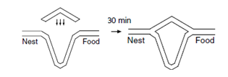
Examples of swarm intelligence algorithms
Ants Stigmergic behaviour:-
Ants, like many other social insects, communicate with each other using volatile chemical substances known as pheromones, whose direction and intensity can be perceived with their long, mobile antennae.

Slide 10
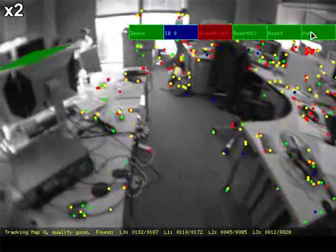
OTHER APPLICATIONS OF THIS COMBINATION
Ultrasonic Position Tracking System
Notes:
Video tracking is an essential tool for systematically studying swarm-behaviour, even though other tracking methods are available. Recently Bristol robotics laboratory developed an ultrasonic position tracking system for swarm research purposes. Further research is needed to find methodologies that allow the design and reliable prediction of swarm behaviour when only the features of the individual swarm members are given.

Slide 11
DEMERITS of the combination
ATMOIC WEAPONS
This combination can increase the vulnerability of the nuclear weapons. These can also become more accessible with nanotechnology and If they are getting developed on a faster pace. Thus it can lead to a huge manmade disaster.
MEDICAL SCIENCE
Even though it might be able to make some highly advanced cures but it could also be responsible for creating some lethal virus for the purpose of control on human beings to a huge extent.
A COMMON DEMERIT
There is the possibility of stagnation: without global knowledge, a group of robots can find themselves in a deadlock situation. Too many robots trying to reach the same location, or perform the same task could obstruct each other.

Slide 12
COUNTERMEASURE FOR NUCLEAR WEAPONS
We will make the nuclear weapons well equipped with body scan.
The robotic interface arrives nearby the nuclear warfare.
There will be generation of sequential programmes in weapons
Now, the weapon activator will perform certain scans related to the body of nanobots.
When these nanobots fail in these tests then the weapons will be safe.
These nuclear weapons will get initialised with such tests.

Slide 13
NanoTechnlogy with Swarm Intelligence
Things will be made ultra-easy
Everything will be in our command
Can increase the precision among the machines

Slide 14
CONCLUSION:-
This presentation tried its best to analyse and provide a near comprehensive study /analysis of the basic components which constitute a nanotechnology system, primarily, focussing on swarm intelligence currently in use and analysing the shortcomings with respect to counter measures employed. The ideas presented here have been devised keeping in mind these limitations and thereby, keeping a future of 2040, in perspective given the ever-changing dynamics in the context of 21st century and keeping in mind that the field of nanotechnology with swarm robotics being the latest in the world should not lag in its quest for development and safeguarding of its economic and scientific interests.

Slide 15
REFERENCES:-
1.B. K. Panigrahi, Y. Shi, and M.-H. Lim (eds.): Handbook of Swarm Intelligence. Series: Adaptation, Learning, and Optimization, Vol 7, Springer-Verlag Berlin Heidelberg, 2011. ISBN 978-3-642-17389-9
2.S. Das, B. K. Panigrahi, and S. S. Pattnaik, Nature-Inspired Algorithms for Multi-objective Optimization, Handbook of Research on Machine Learning Applications and Trends: Algorithms Methods and Techniques, Hershey, New York, Vol. 1, pp. 95–108, 2009.
3.A. P. Engelbrecht (ed.), Computational Intelligence: An Introduction. John Wiley & Sons, England, 2002.
4.D. Karaboga and B. Basturk, A Powerful And Efficient Algorithm For Numerical Function Optimization: Artificial Bee Colony (ABC) Algorithm, Journal of Global Optimization, Springer Netherlands, Vol. 39, No. 3, pp: 459-471, 2007.
5.R. C. Eberhart and J. Kennedy. A new optimizer using particle swarm theory. In Proceedings of the Sixth International Symposium on Micro Machine and Human Science, Nagoya, Japan, pp. 39–43, 1995

Slide 16
THANK YOU
QUESTIONS AND COMMENTS

