Slide 1

Energy Auditing Of Ship
MAHARASHTRA ACADEMY OF NAVAL
EDUCATION & TRAINING
By
Apurv Rao
Tejas Paranjape
Karan Rathod
(Semester IV)

Slide 2
What Is Energy Auditing?
Energy: Is capacity to do work
Audit: Official scrutiny of accounts
Energy Audit: the verification, monitoring and analysis of use of ENERGY including submission of technical report containing recommendations for improving energy efficiency with cost benefit analysis and an action plan to reduce energy consumption
Notes:
Add everything karan says to be included in slide in brief

Slide 3
-Energy audit is Holistic and Systematic assessment of ship
Technical factor
Non- Technical Factors

Slide 4
Objectives of Energy Auditing
The shipboard audit has three main objectives
To assess the status of the ship and its major machinery
To assess the ship’s operational management processes
To validate the quality of measured data so as to:
- Reduce rationally the fuel cost
-Reduce rationally atmospheric emission
The other secondary objectives which are of contemporary significance are……

Slide 5
The type of Energy Audit to be performed depends on:
- Function and type of industry
- Depth to which final audit is needed, and
- Potential and magnitude of cost reduction desired
Thus Energy Audit can be classified into the following two types.
i) Preliminary Audit
ii) Detailed Audit

Slide 6
Energy Audit
Preliminary Audit
Energy consumption
Scope for saving
Improvements and savings
Detailed Audit
Phase I – Pre Audit Phase
Phase II - Audit phase
Phase III- Post Audit Phase

Slide 7
Procedure of Auditing
Typically an energy audit is dependent upon the
-Ship type
-Ship size
-Data
-Organization onboard
3-5 days are required for measurements and data gathering
The final report is submitted within 1 month after the audit
Notes:
Talk as per the content.
Add a slide which includes upcoming technologies
Change background
Colour

Slide 8
The energy audit cycle
Assess performance
set goals
Create action Plan
Re assess
Recognize achievements
Implement action Plan
Evaluate progress

Slide 9
Benchmark for Auditing
- Technology, processes used and equipment details
- Capacity utilization
- Amount & type of input materials used
- Water consumption
- Fuel Consumption

Slide 10
- Electrical energy consumption
- Steam consumption
- Other inputs such as compressed air, cooling water etc
- Quantity & type of wastes generated
- Percentage rejection / reprocessing
- Efficiencies / yield

Slide 11
Following are the categories along which scrutiny is done
Energy consumption
a)by type of energy,
b)by department,
c)by major items of process equipment
2. Material balance data
3. Energy cost and tariff data

Slide 12
4. Process and material flow diagrams
5. Generation and distribution of site services
6. Potential for fuel substitution, process modifications
7. Energy Management procedures and energy awareness training programs within the establishment.

Slide 13
Need for audit
Top operating expenses
Energy Labour Materials
Energy Audit will help to understand more about the ways energy and fuel are used in Shipping industry, and help in identifying the areas where waste can occur and where scope for improvement exists.

Slide 14
The primary objective of Energy Audit is to determine ways to reduce energy consumption per unit of product output or to lower operating costs.
It leads the manufacturers to new hunting grounds to search for potential innovations

Slide 15
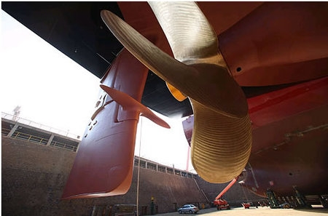
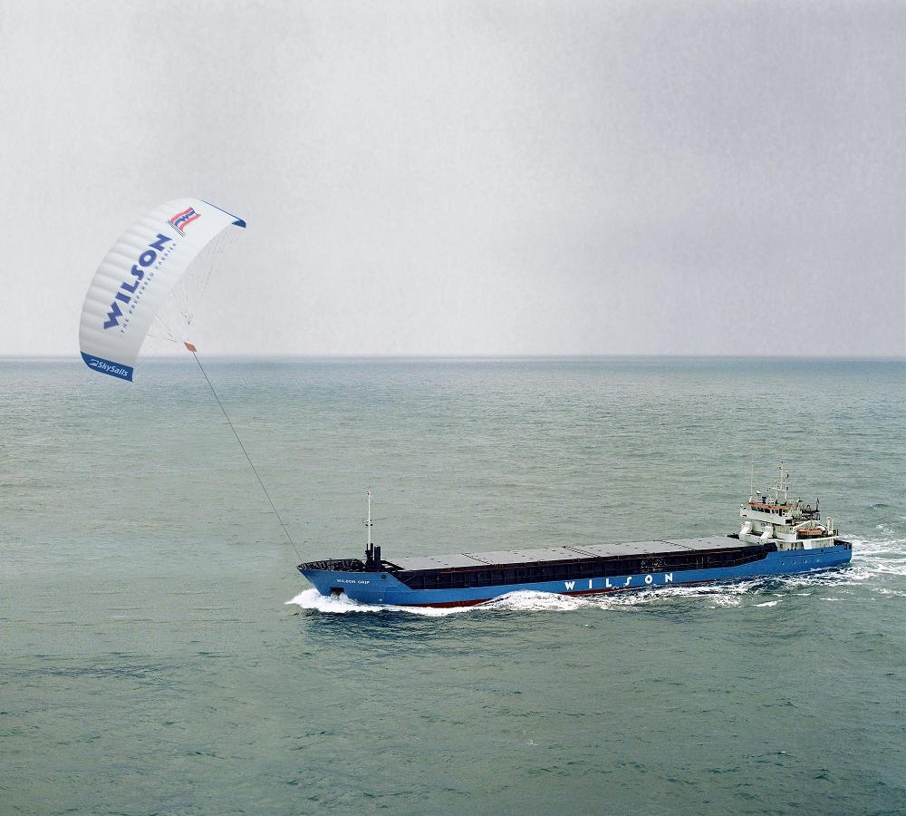
These are some of the potential innovations that have come up post audit for saving energy
Kite surf
Thrust fins
Ballast free VLCC
Fuel cell
Solar powered Ship
Notes:
Carbon footprints

Slide 16
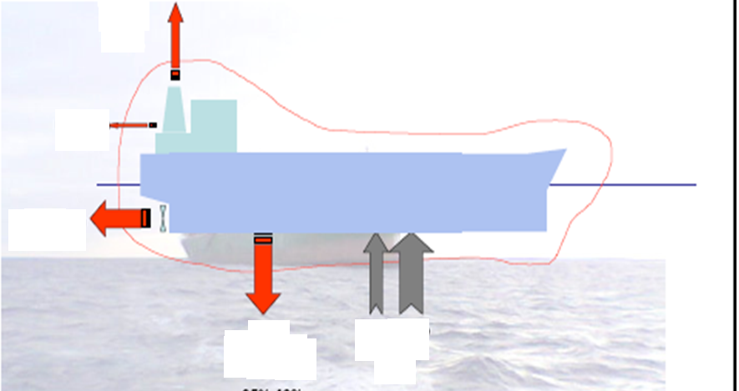
Exhaust
Gases
18-22%
Radiation
1.5%
Propulsion
≈35-48%
Low temperature
Heat sources
≈25-42%
HFO+MDO
100%
Notes:
table

Slide 17
Some points that are worth to check
Auxiliary Diesels engines are very often operated below 50% load, for reasons of safety or tradition?
A Diesel alternator presents a higher specific fuel consumption when operated at low loads than when operated above 80%, clogging the turbochargers diffusers, piston rings, reducing engine efficiency.

Slide 18
The emissions increase drastically, specially when operated with MDO or HFO
The maintenance expenses increase exponentially for low loads.
When buying a ship project, the shipyard will sell the cheaper cooling water system, i.e., a big sea water circulating pump and a small central heat exchanger
So you will pay less on the first investment but you will be paying through all vessels life!

Slide 19
Applications/Benefits
Depending on the category of ship, companies can save up to 25- 30% of their fuel costs by slowing down. For example for a fishing vessel slowing down from 24 knots to 20 knots.
Vessels hull painting schemes, propeller polishing etc. have been investigated to cut operation costs

Slide 20
By introducing a variable speed drive to control the water flow, and adding some more plates, we can recover of about 50% of the energy actually spent on the cooling water system. This is a lot of money, and much less pollution.
Carbon footprints will be reduced.
Environment friendly voyages

Slide 21
CONCLUSION
Ship Energy Audit pinpoints the areas that are leading to unnecessary fuel consumption and identifies practical measures to save energy. An audit can assist in cutting emissions and demonstrating compliance with energy management’s best practice.
Notes:
suggest

Slide 22
Thank You

Slide 23
Our Special thanks to:
C/E S. Chitre
Prof S. Gambhire
C/E P. Shinde
Who have extended their endless support and guidance to get us through this presentation.
Notes:
Cut down names

