Slide 1
Transtech’14
SOCIOECONOMIC IMPACT OF FUTURISTIC TECHNOLOGY

Slide 2
SMART MATERIALS
FOR SMART FUTURE
C V RAMAN
COLLEGE
OF
ENGINEERING
Presented by:-
Arindam Bhattacharya
Hemant Kumar
Pradeep Kumar Rajput
Saurabh Kumar

Slide 3
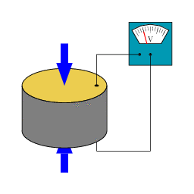
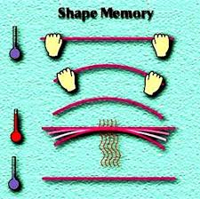
WHAT ARE SMART MATERIALS ?
Smart materials are designed materials that have one or more properties that can be significantly changed in a controlled fashion by external stimuli, such as stress, temperature, moisture, pH, electric or magnetic fields.
Piezoelectric Materials
Shape-memory Alloy

Slide 4
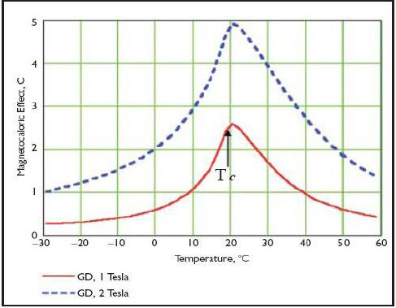

What is
MAGNETOCALORIC EFFECT ?

Slide 5


Slide 6
Merits :-
The efficiency of magnetic refrigeration is 60% to 70% as compared to Carnot cycle.
Maintenance free and simple in construction.
Running cost are 20% less than conventional chillers.
Demerits :-
The initial investment is more as compared with conventional refrigeration.
The MAGNETOCALORIC materials are rare Earth materials.

Slide 7
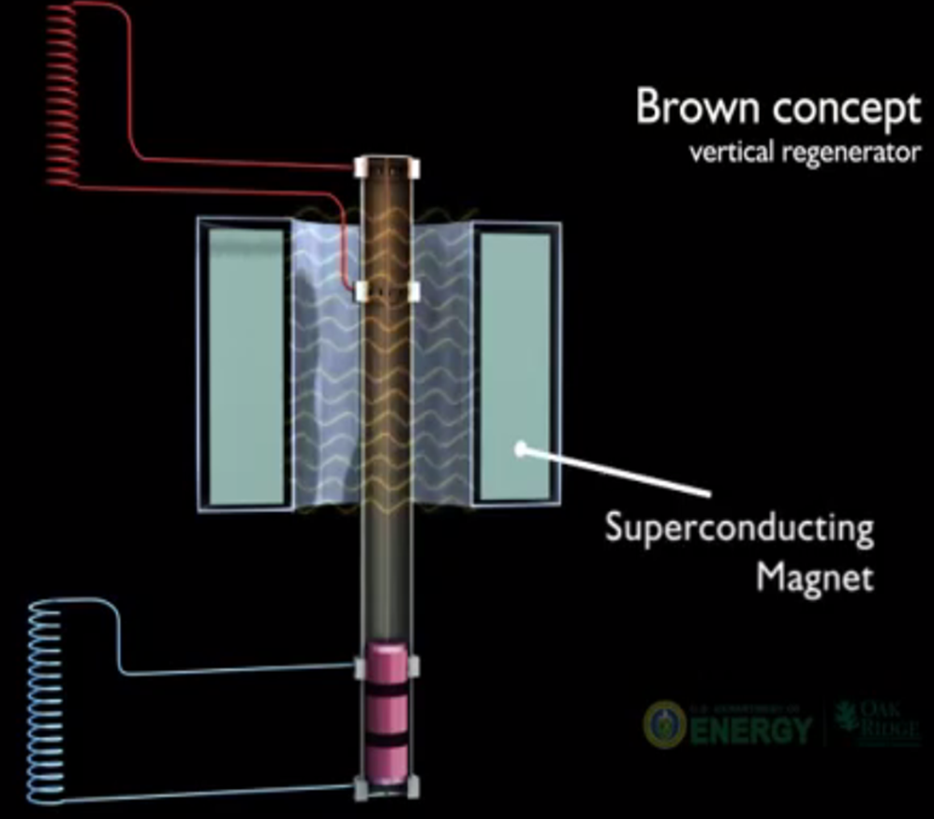
FUTURE MODELS

Slide 8
FUTURE APPLICATION
Ships
Household
Applications
Medicines
Transportation
Spacecraft
Electronics Equipments
COOLING and AIR CONDITIONING

Slide 9

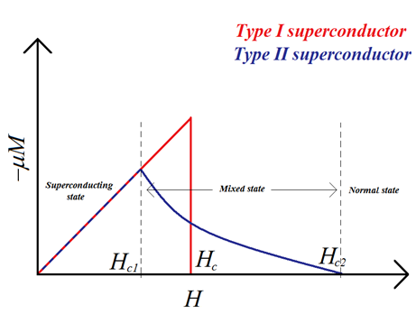
WHAT IS SUPERCONDUCTIVITY?
It is a phenomenon of exactly zero electrical resistance and expulsion of magnetic fields occurring in certain materials when cooled below a characteristic critical temperature.
TYPES OF SUPERCONDUCTORS :-
Based on magnetization behavior of superconductor in external magnetic field
Based on superconducting transition temperature
Low Temperature Superconductor (Transition temperature less than 20K)
High Temperature Superconductor (Transition temperature greater than 20K)

Slide 10
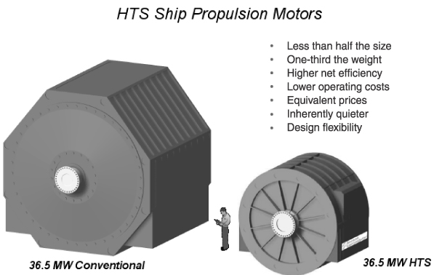
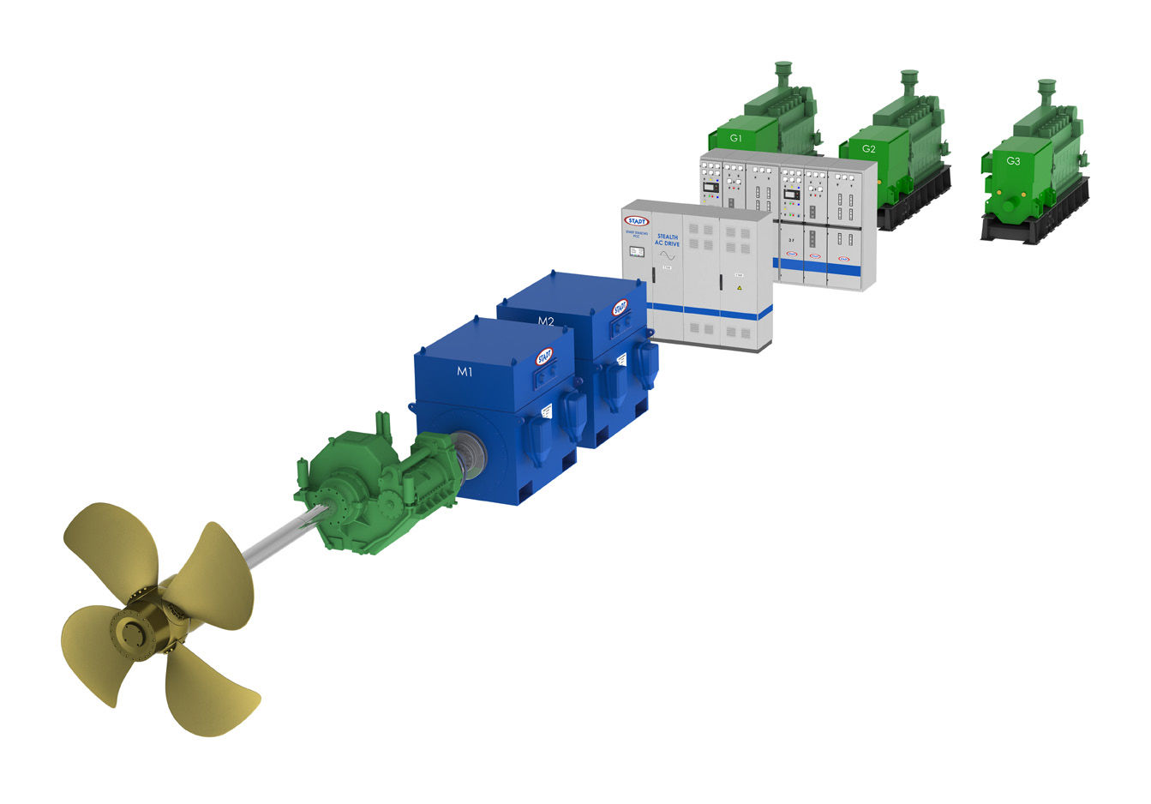
High Temperature Superconductor Application
High Temperature Superconductor Electrical Machine.

Slide 11
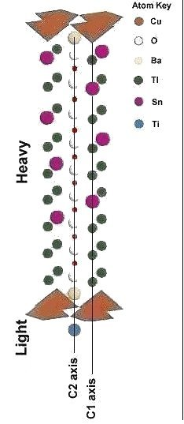
RECENT DEVELOPMENTS:-
November 2013 - SILICON based superconductor (Tc=326K)
January 2014 - TITANIUM based superconductor (Tc=338K) -Tl₇Sn₂Ba₂TiCu₁₀O₂₀₊.

Slide 12
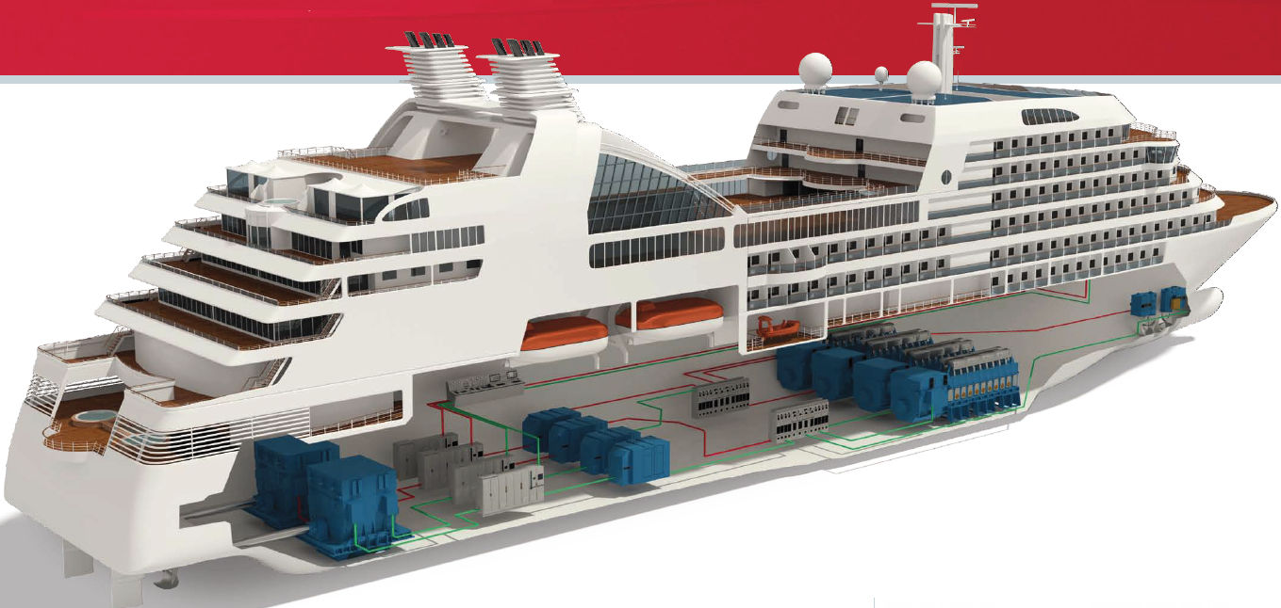
Future Ship
HTS MOTOR PROPULSION SYSTEM

Slide 13
Economic Impact of Superconducting Equipment
Utilities
Higher density transmission uses and higher
economic productivity, and environmental friendly
Industrial
Electrical storage, transmission and expansion
Transportation
High Speed Rail and MAGLEV technologies Electric car, bus, Ship.

Slide 14
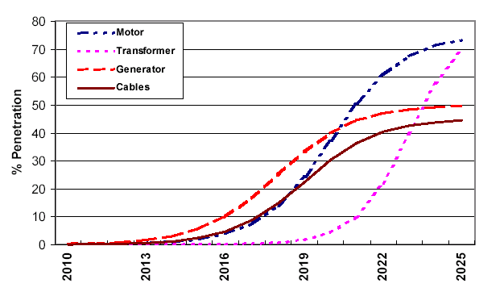
Forecasted Market Penetration Curves
Source: Analysis of Markets and Future Prices for High Temperature Superconductors

Slide 15
HTS ENERGY SAVINGS (GWH)
Year | Motor | Transformers | Generators | Cables | Total
2009 | 0 | 0 | 2 | 1 | 3
2011 | 0 | 0 | 11 | 3 | 14
2013 | 1 | 0 | 44 | 13 | 58
2015 | 4 | 0 | 171 | 55 | 231
2017 | 15 | 2 | 556 | 196 | 769
2019 | 57 | 15 | 1417 | 598 | 2086
2021 | 154 | 94 | 2699 | 1336 | 4283
2023 | 300 | 449 | 4196 | 2289 | 7235
2025 | 468 | 1194 | 5785 | 3326 | 10774

Slide 16
EMISSIONS SAVINGS ATTRIBUTABLE TO HTS DEVICES
Year | Energy saving (GWH) | Carbon Savings (Metric Tons) | SOX Savings (Metric tons) | NOX Savings (Metric Tons)
2009 | 3 | 489 | 6 | 3
2011 | 14 | 2271 | 29 | 13
2013 | 58 | 9183 | 113 | 52
2015 | 231 | 36269 | 434 | 201
2017 | 769 | 129716 | 1384 | 657
2019 | 2086 | 324801 | 3594 | 1749
2021 | 4283 | 662176 | 7099 | 3510
2023 | 7235 | 1109613 | 11662 | 5765
2025 | 10774 | 1638940 | 16891 | 8351

Slide 17


